Slide 1
Dear Students,
Before your 2020-2021 Spring Semester synchronous Final exams, you must sign in to the Zoom application with your student email having @bilgiedu.net extension.
lms.support@bilgi.edu.tr

Slide 2
If you do not know your Zoom password created with your BİLGİ student e-mail, you can click on "Forgot?" in the password field in the application.
On the zoom.us password reset page that opens, you should write your student e-mail and send the reset e-mail.
When you receive the password reset email, you must set a new password.
lms.support@bilgi.edu.tr

Slide 3
Before your Final exam, you should log in to the Zoom application with your student email with the extension @ bilgiedu.net and ensure that the application is open on your computer desktop.
Note: Otherwise, your name will not appear in the official attendance list.
lms.support@bilgi.edu.tr

Slide 4
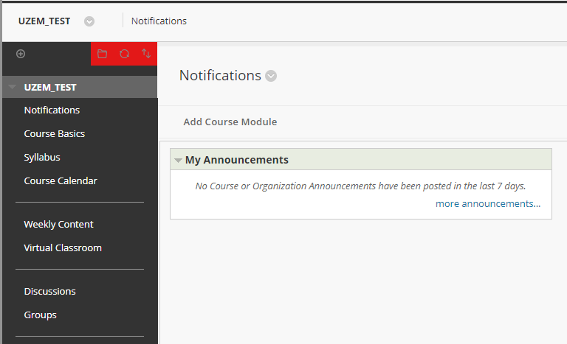
At the time of the exam, you must log in to learn.bilgi.edu.tr page with your BİLGİ Learn account via Google Chrome browser.
Go to your course page where your Final exam is created and click the "Virtual Classroom" link of the course.
lms.support@bilgi.edu.tr

Slide 5
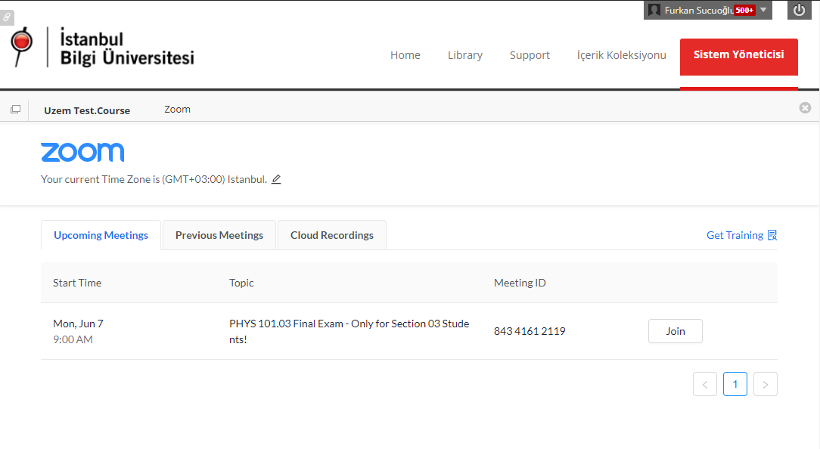
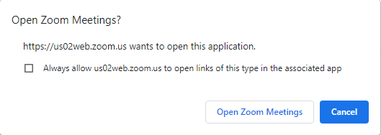
You can join the relevant exam session by clicking the "Join" button.
In your multi-section courses, you should make sure that you connect to the session of your section.
You should click the "Open Zoom Meetings" button in the pop-up window that opens and log into your Zoom application.
lms.support@bilgi.edu.tr

Slide 6
During the exam, you must connect to the learn.bilgi.edu.tr page via Google Chrome browser.
You must connect to the Zoom session created for the Final exam through the virtual classroom of your course page.
You must connect to the Zoom session at least 15 minutes before the exam time in order to finalize the exam preparations.
At the beginning of the exam, you will be asked to show your IDs with a photo (Student ID / TC ID card / Driving License / Passport) to the camera. Therefore, you should prepare your IDs in advance.
You must not leave the Zoom session or turn off your camera before your exam period is over.
During the exam, you must not turn on your microphone unless the course instructor requests you to turn it on.
lms.support@bilgi.edu.tr

Slide 7
Your face must be clearly seen and you must not wear headphones during the exam. If you have to do otherwise, please share this with the invigilators in advance.
In order not to trouble your connection during the exam, please make sure that any applications running in the background and using an internet connection are turned off.
If you encounter any unexpected problems in your exams, you can request support by sending an e-mail to lms.support@bilgi.edu.tr.
Audio and video recording of the session will not be taken during the exam.
lms.support@bilgi.edu.tr

