Slide 1
Thermistors
Mehmet Okur
Feb. 3rd, 2016
SIU 2016, Zonguldak

Slide 2
SLIDE TITLE
Content here

Slide 3
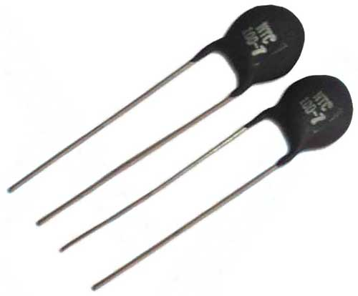
SLIDE TITLE
Al lead
Fig. 1 Thermistor view [1]
Fig. 2 Temperature vs. Resistance plot

Slide 4
References
IEEE format citation here

Slide 5
Thank you for your attention

Slide 6
Additional slides for Q&As

