Slide 1
INTERNATIONAL STUDENT ADVISING OFFICE
HOW TO UPDATE CONTACT INFORMATION

Slide 2
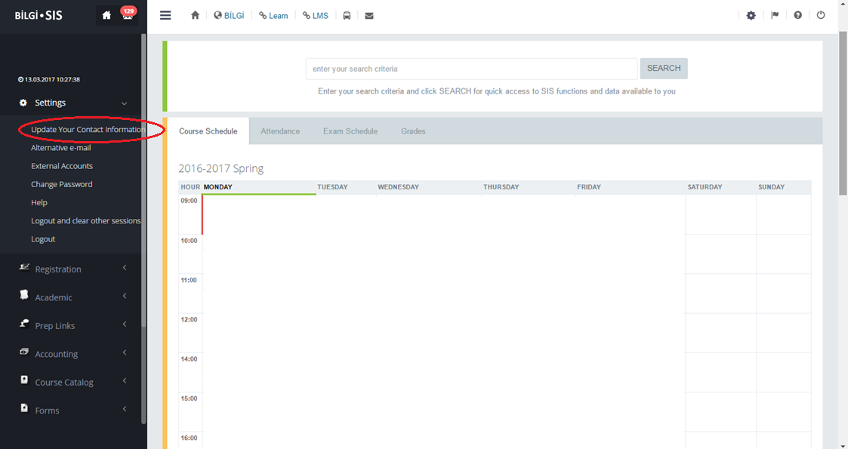
1.
Please log into your SIS student page and follow the steps below to update your contact information.

Slide 3
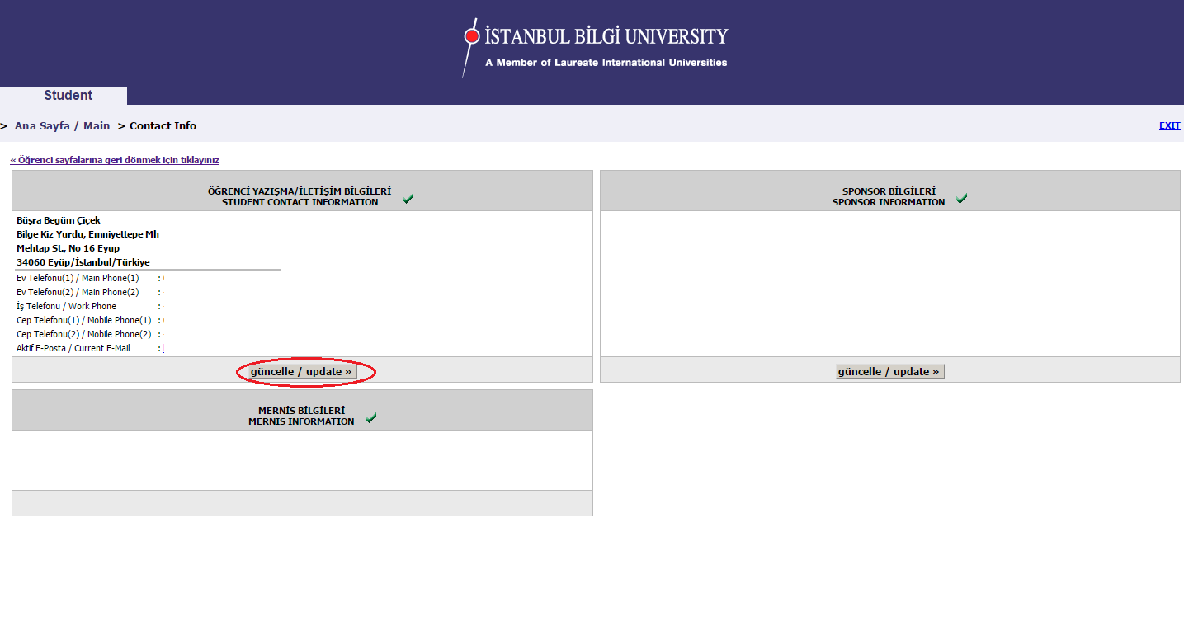
2.

Slide 4
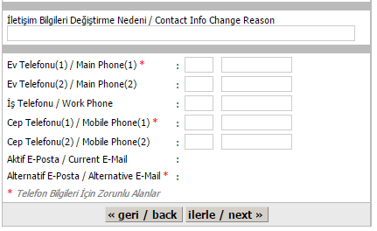
3.

Slide 5
4.

