Slide 1

Welcome to
İstanbul Bilgi University
International Center - International Student Advising Office

Slide 2

Please choose the marked area which means ‘’I lodge the application for residence permit for the first time’’
“
”

Slide 3
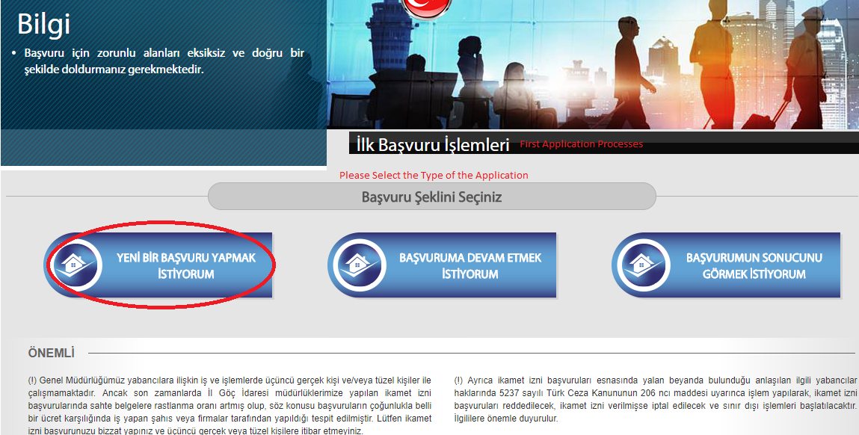
Then you need to select the Type of the Application. In this case please choose the marked area which means ‘’I would like to lodge a new application’’
“
”

Slide 4
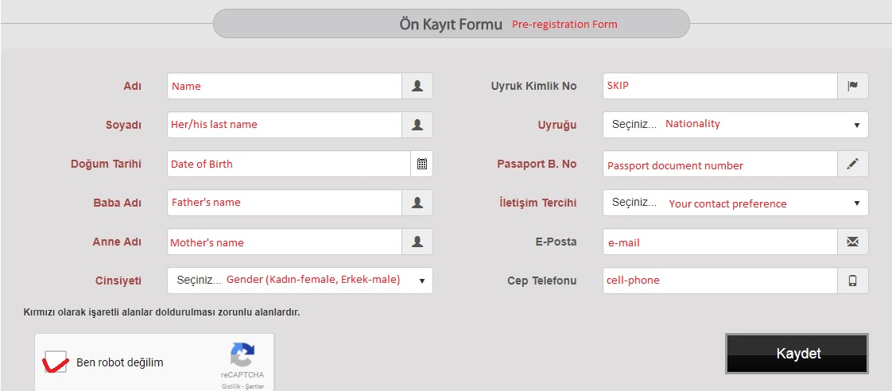
Please, follow the instructions
“
”

Slide 5
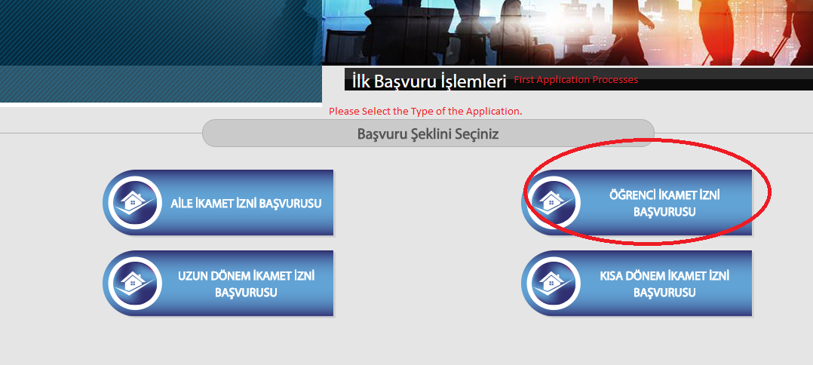
Then you need to select the Type of the Application. In this case please choose the marked area which means ‘’Student residence permit application’’
“
”

Slide 6
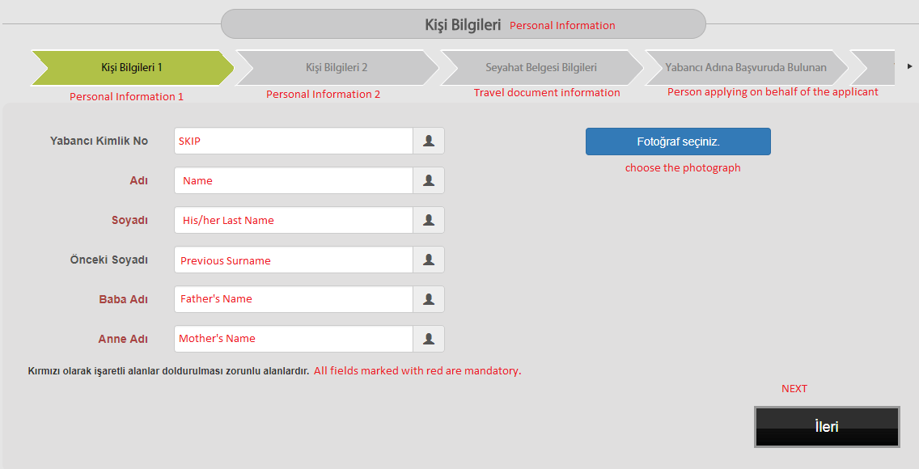
Please, follow the instructions
“
”

Slide 7
Please, follow the instructions
“
”

Slide 8
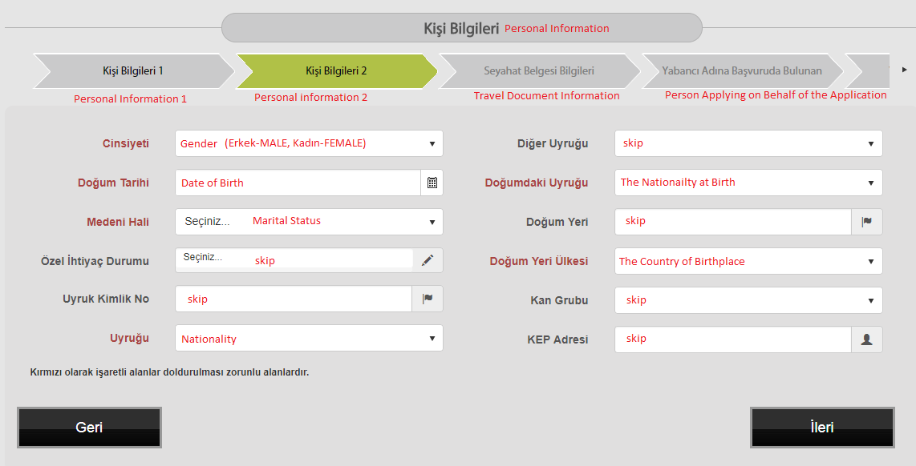
Please, follow the instructions
(Marital Status info:
*Bekar-single,
*Evli-married,
*Boşanmış-divorced)
“
”

Slide 9
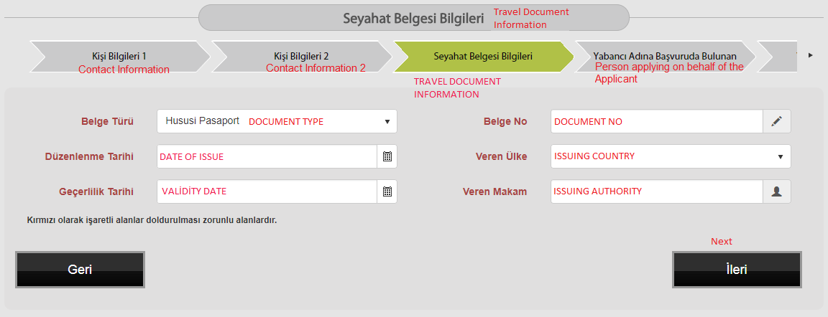
Choose the HUSUSI Pasaport which means ‘’Ordinary Passport’’
“
”

Slide 10
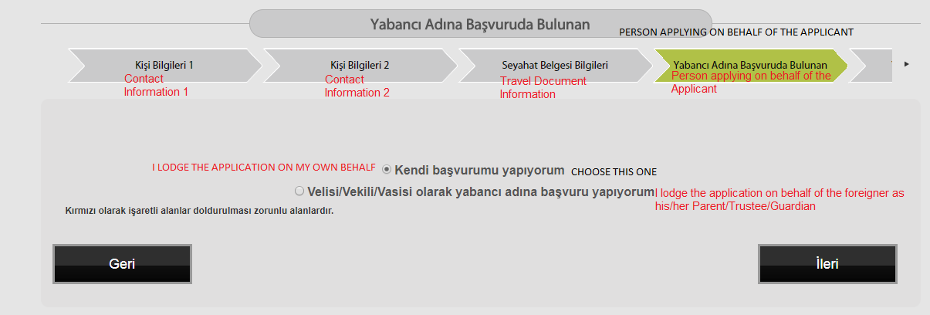
Please, follow the instructions
“
”

Slide 11
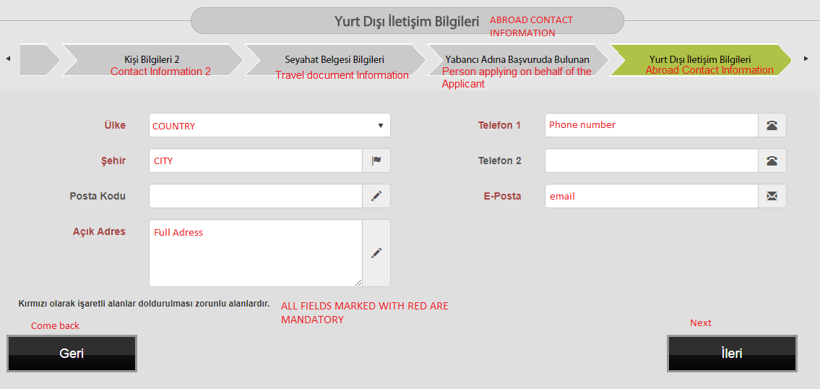
Home address information (not in Turkey, country that you live in)
“
”

Slide 12
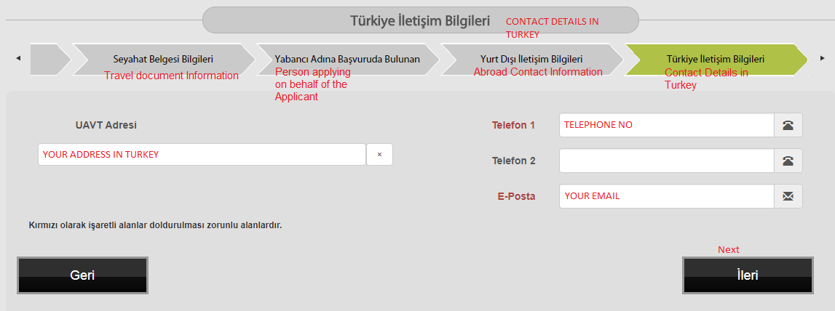
Here you will enter your TURKISH adress and TURKISH PHONE NUMBER. Be sure that the number you enter is the working one, because they will use it to inform you when your Ikamet arrives!
“
”

Slide 13
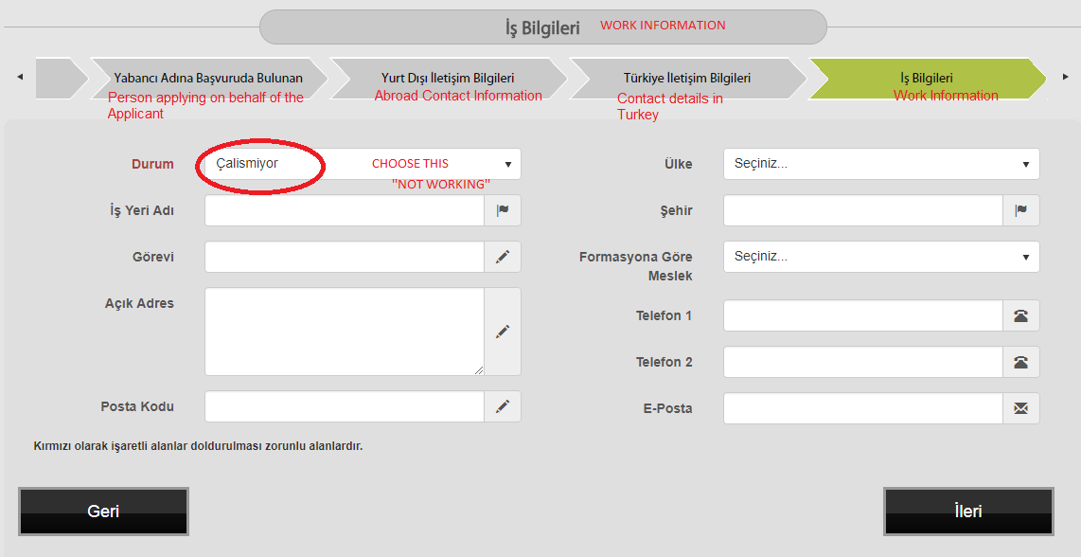
Choose - not working - çalismiyor
“
”

Slide 14
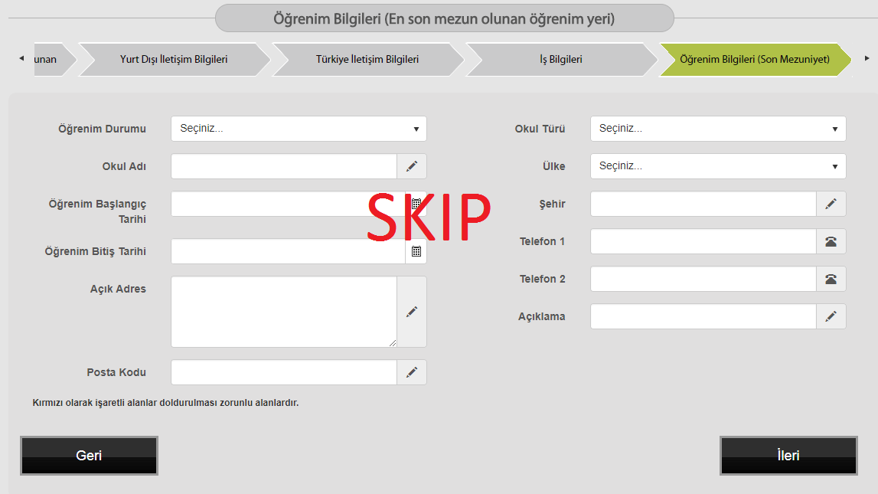
You may skip this part
“
”

Slide 15
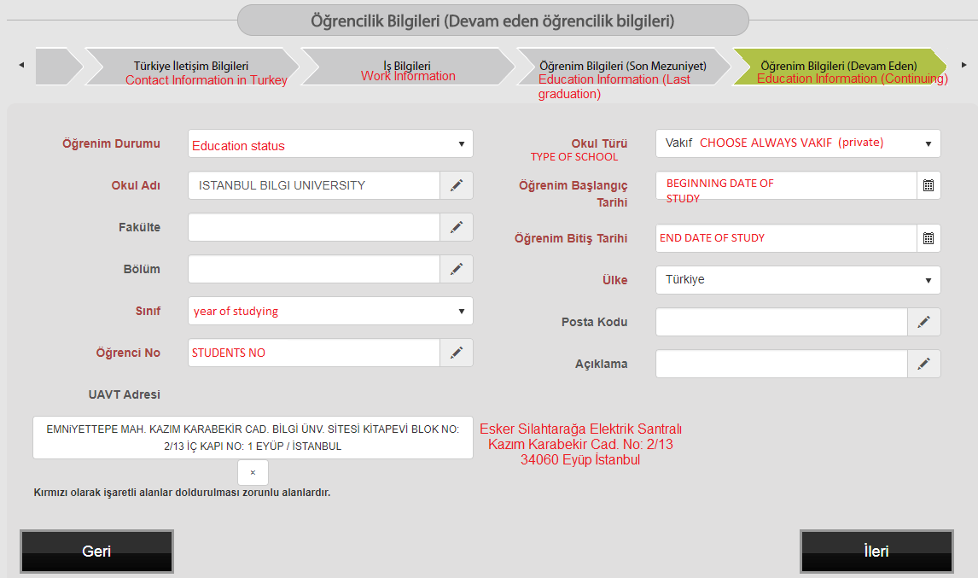
Please, follow the instructions
“
”

Slide 16
Please, follow the instructions
“
”

Slide 17
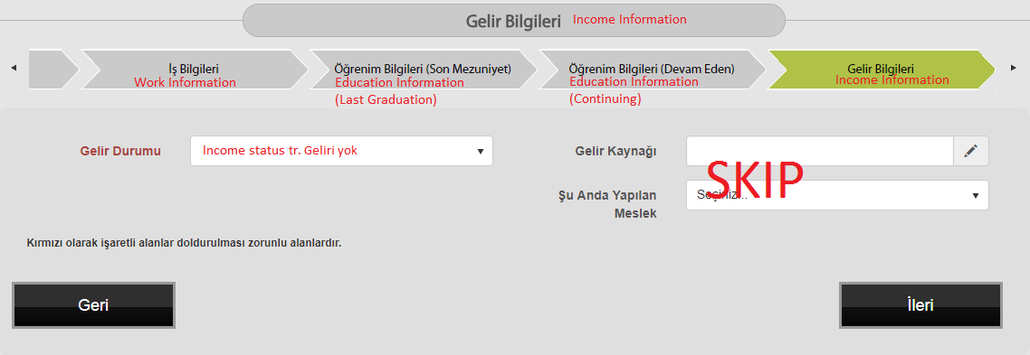
Please, follow the instructions
(choose GELIRI YOK)
“
”

Slide 18
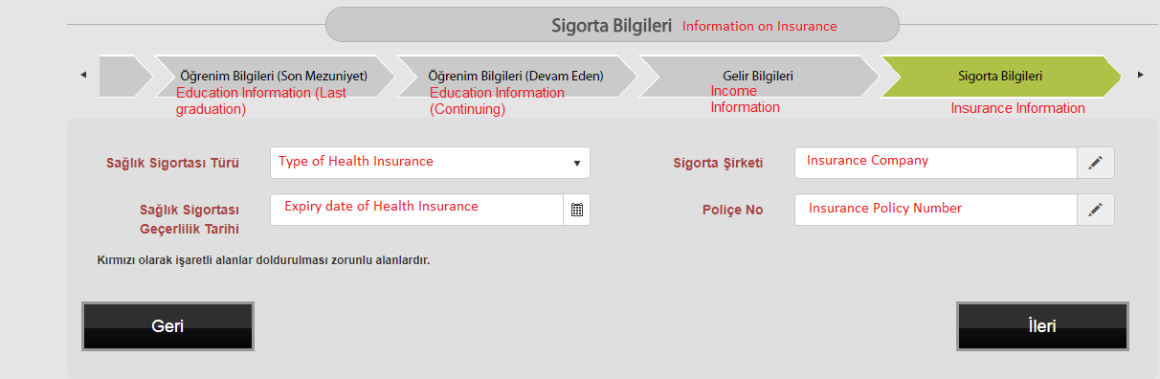
Please, follow the instructions
“
”

Slide 19
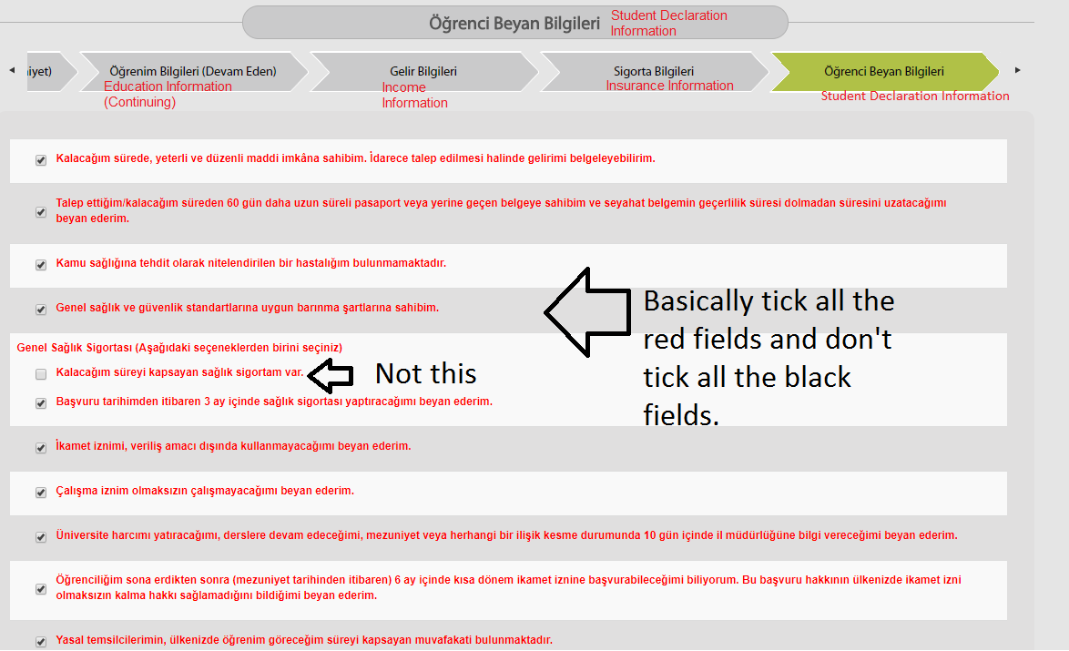
Please, follow the instructions
“
”

Slide 20
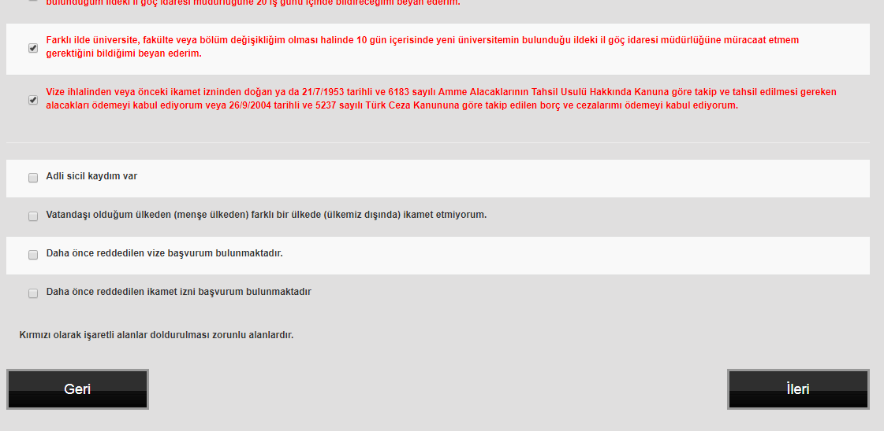
Please, follow the instructions
“
”

Slide 21
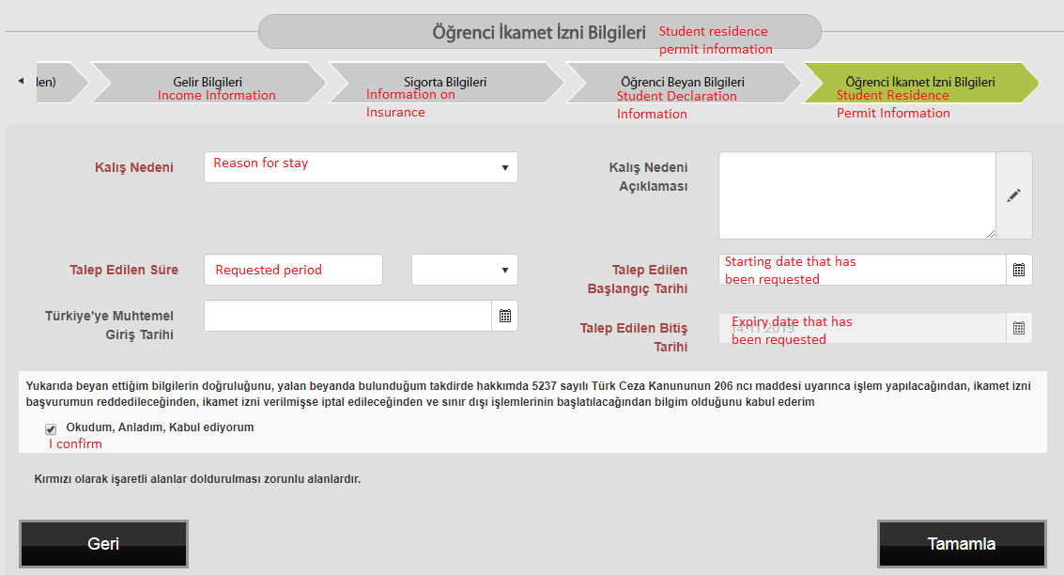
Requested period should be until your study period, HOWEVER if your passport is expiring before your estimated graduation, you need to set the date for 60 days prior to the expiry date
“
”

Slide 22
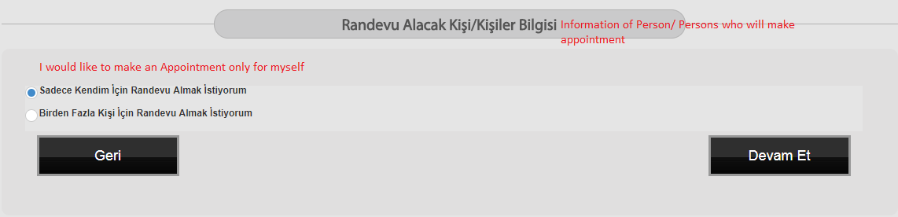
Please, follow the instructions
“
”

Slide 23
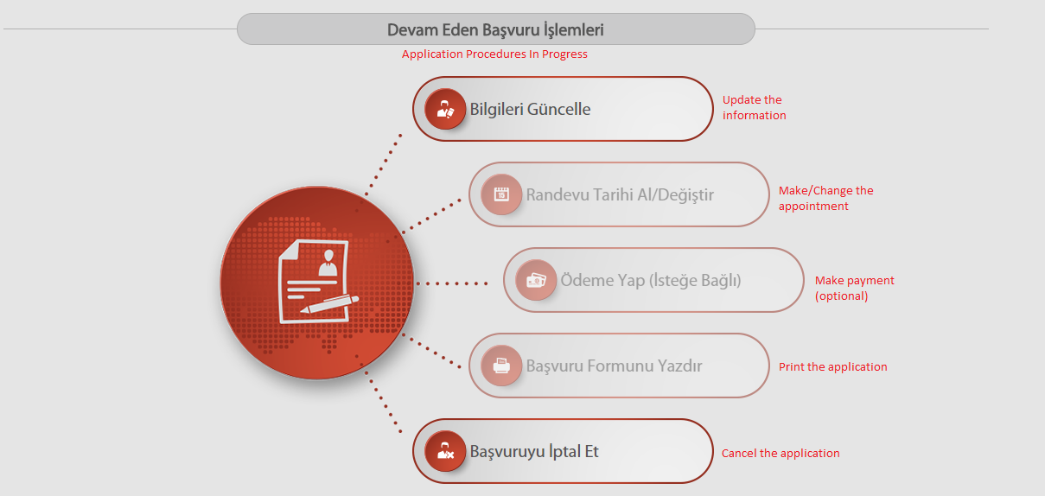
After you update all the informations correctly (Bilgileri Güncelle) you may choose the date of your APPOINTMENT ‘’ Randevu Tarihi Al/Değiştir’’.
“
”

Slide 24
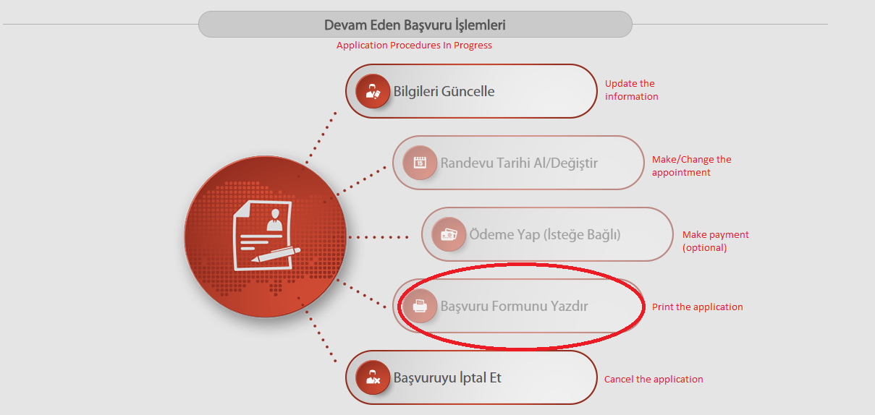
Then do not forget to PRINT YOUR APPLICATION FORM (Başvuru Formunu Yazdır)
“
”

