Slide 1


Slide 2


ALLIANZ IS BY YOUR SIDE, IN SICKNESS AND HEALTH!

Slide 3
WHY IS HEALTH INSURANCE POLICY NECESSARY?

Slide 4


Allianz Health Insurance Policy Covers Your Health Risk In Turkey
You Need A Health Insurance Policy For Residence Permit

Slide 5
Allianz Health Insurance Policy Covers Your Health Risk In Turkey

Slide 6
Policy Cover Details
Allianz Health Insurance policy includes two main treatments. These are;
Inpatient treatment unlimited : Allianz covers 100 %
Outpatient treatment limit 2000 TL : Allianz covers 60 %

Slide 7
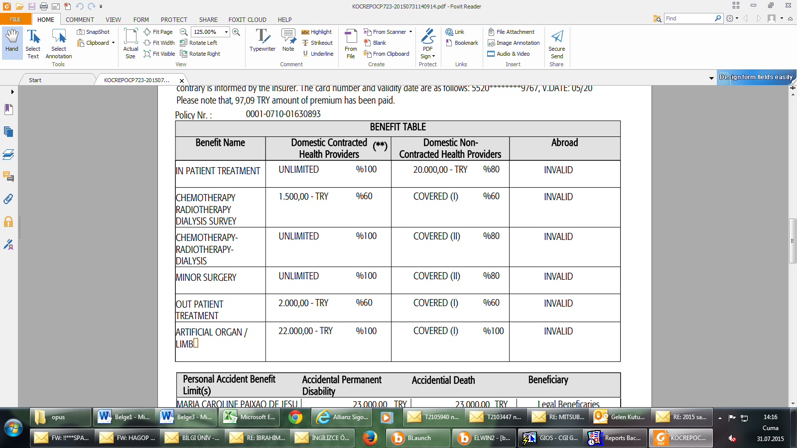

Slide 8




Contracted Health Providers
Allianz has agreement with many Hospitals in Turkey, you can find more Contracted Health Hospitals at Allianz web site .
We recommend these hospitals for use.
Florence Nightingale Hospital–Şişli
Memorial Hospital-Şişli
Florence Nightingale Hospital-Gayrettepe
Acıbadem Hospital-Fulya
Liv Hospital- Ulus
We don’t have any agreement with American Hospital in this plan.

Slide 9

When you have any problem about your Health Insurance at the Hospital, please call the these contacts.
Ms. Dilek AKKUŞ - (+90) 541 782 65 84
Mr. Okan SARI - (+90) 539 657 00 59
Mr. Cem NİĞDELİ - (+90) 535 342 43 41

Slide 10
HOW CAN I USE MY ALLIANZ HEALTH INSURANCE POLICY
When you go to Hospital you can show your Allianz Health Insurance Card or Policy Number to Hospital Officer.
After the hospital officer ask for the provision the system will respond automatically.

Slide 11
Exclusion Situation
The previously existing illnesses are not covered by the policy.
There is a 12-month waiting period for people who will be insured for the first time in some diseases.

Slide 12

Waiting Periods for Treatments
Waiting Periods for Treatments
Regardless of the treatment nature (inpatient/outpatient), expenses related to the treatments, complications, physical therapy and rehabilitation procedures performed in relation to the following diseases and illnesses are covered under the relevant benefits only after 12 months of enrolling into the policy.
Gall bladder and/or biliary tract diseases,
All kinds of hernias,
Vertebral column and disk diseases,
Desmoids cyst sacral,
Anorectal diseases,(ex: hemorrhoid , fissure)
Uterine and ovarian diseases,
Tonsils and adenoid diseases,
Nasal polyps,
Cranial sinus diseases,
Knee, shoulder, hip, elbow joint diseases and lesions (ex: meniscus, ligament injuries and chondral fractures),
Cataract,
Prostate diseases,
All kinds of varicose,
Hydrocele,
Kidney and urinary system stones,
Thyroid gland diseases

Slide 13
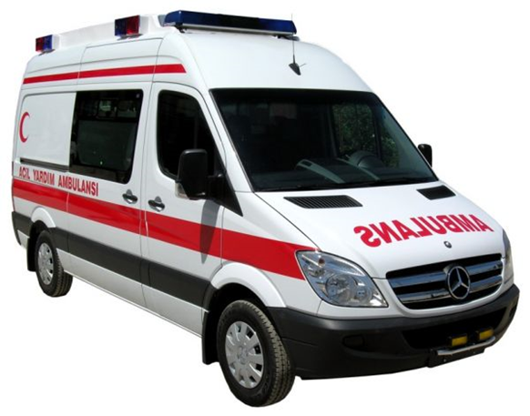
ALLIANZ AMBULANCE
ALLIANZ CUSTOMER SERVICE: 0850 399 9999
Policy has an Emergency Service 100 % Unlimited.
People who need Ambulance they use free by using call Allianz Customer Service.
For only Emergency Situations

Slide 14
2. You Need A Health Insurance Policy For Residence Permit

Slide 15
Residence Permit
Foreign International Student will be covered by the Private Health Insurance if they are required within 3 months of the first arrival date.
For this reason; International Students, who live Turkey, need Private Health Insurance for Place of Residence.

Slide 16
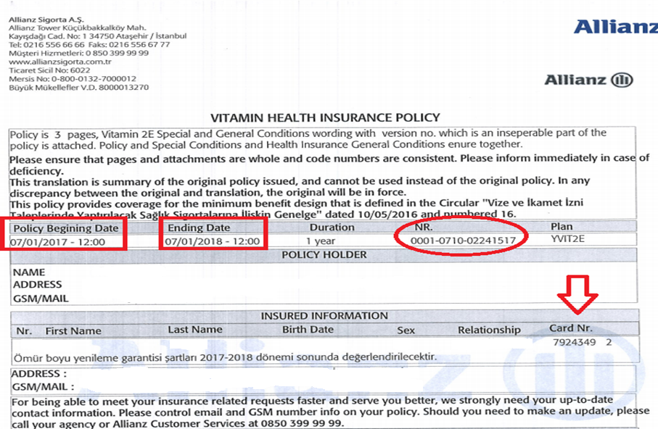

Slide 17
WHAT SHOULD APPLY TO REGISTER
Application form
You can find application form on Erasmus Office
-Passport Identity (Passport Number)
-Student Certificate (Bilgi Uni)
-Copy of Passport
-Payment Plan. You can pay with credit card or bank transfer
Payment receipt must be person who make a money transfer, their names and surnames

Slide 18
Payment Table
Year of birth | Total cost per year
1983 | 242.03 TL
1984 | 242.03 TL
1985 | 242.03 TL
1986 | 242.03 TL
1987 | 242.03 TL
1988 | 242.03 TL
1989 | 232.96 TL
1990 | 232.96 TL
1991 | 232.96 TL
1992 | 232.96 TL
1993 | 232.96 TL
1994 | 175.93 TL
1995 | 175.93 TL
1996 | 175.93 TL
1997 | 175.93 TL
1998 | 175.93 TL
1999 | 175.93 TL
2000 | 175.93 TL
Payment Change Depends on Student's Birth Year.

Slide 19


PROCESS
Fill In Application Form
When filled the application form, you could deliver it to International Student Office. Tanyıldızı Agency will deliver it to Allianz Health Insurance Department
Allianz will check and approve the application form then they prepare policy and insurance card
When the policy is ready, Tanyıldızı Agency will deliver it to International Student Office.
Approximately, 7 working days

Slide 20
If You Require Any Further Information Feel Free To Contact Us.
Ms. Dilek Akkuş
dilek@tanyildizisigorta.com
T 16 İş Merkezi Meriç Cad. Kamelya Çarşı No:26 Ataşehir /İSTANBUL
T:0216 456 81 11
F:0216 456 47 37
C: (+90) 541 782 65 84
www.tanyildizisigorta.com
Mr. Okan SARI
okan@tanyildizisigorta.com
T 16 İş Merkezi Meriç Cad. Kamelya Çarşı No:26 Ataşehir /İSTANBUL
T:0216 456 81 11
F:0216 456 47 37
C: (+90) 539 657 00 59
www.tanyildizisigorta.com

Slide 21
THANK YOU FOR PARTICIPATING

