Slide 1
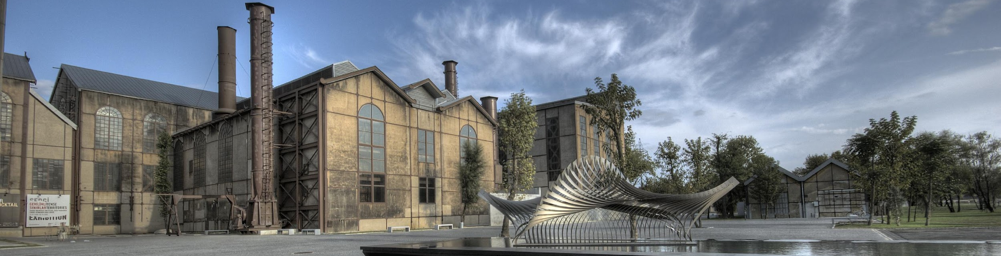
Welcome to
İstanbul Bilgi University
International Center - Erasmus Office

Slide 2
Step by Step
Residence Permit Application

Slide 3
REQUIRED DOCUMENTS
Passport or travel documents
Four Passport size photos (biometric photo must be taken within the last 6-months: frontal, clear face, in a way that the foreigner can be recognized easily, with a white background – please have this photo as scanned version in your computer).
Photocopy of passport pages (the page with your photo, the page where validity and expiry dates are written, and the page of the last entry).

Slide 4
REQUIRED DOCUMENTS
Card fee payment receipt (can be done at Hisar Tax Office).
The payment receipt and a copy of the receipt for residence permit card. The payment amount is 72 TL.
Student Certificate stamped and signed by the Student Affairs Office ( For residence permit we will gather it for you ☺ )
Printout of your online application form signed by the student (must be coloured print)
Statement of Income (You can find it in your welcome pack)

Slide 5
REQUIRED DOCUMENTS
Health Insurance Policy (If you’re bringing your own health insurance from your home country it has to be approved from their Turkish branch. Also it has to be translated in Turkish and approved by the Notary in Turkey. Please be aware that this regulation is only valid for Erasmus Exchange Students)
Document of Address Information (You can find it in your welcome pack. Please for your residence permit process write your address same as with International Center’s)
E-visa printout (for students who have e-visa)

Slide 6

PAYMENT FOR RESIDENCE PERMIT
You need to pay 72 TL for the Residence Permit card fee in one of
two tax offices that are listed below:
HİSAR VERGİ DAİRESİ (SİRKECİ)
Address: Hobyar Mh. Yalıköşkü Cd. No:16-20 Sirkeci /Fatih
GELİR İDARESİ BAŞKANLIĞI (VATAN CADDESİ)
Address: Akşemsettin Mahallesi Adnan Menderes Bulvarı (Vatan Cad.) No:56 Fatih
Make sure to get a receipt of the payment and take a copy of the receipt for yourself.

Slide 7
!
https://e-ikamet.goc.gov.tr/
YOU HAVE TO GET YOUR APPOINTMENT AFTER YOUR ARRIVAL IN TURKEY WITHIN ONE MONTH OF STAYING HERE ON THE
USE ENGLISH KEYBOARD WHEN YOU ARE GETTING YOUR APPOINTMENT!!!

Slide 8
!
NOTICE
Online Residence Permit Application Sessions!!!!
For the students who are applying for the residence permit for the first time, instead of applying alone, you may join Online Residence Permit Application Sessions
(More details will be sent by an e-mail).
In those sessions we will help you with your online application
so don’t panic ☺

Slide 9

HEALTH INSURANCE
You may choose any other insurance company but
ALLIANZ and GUARD ME are in collaboration with our university.
That might save you some time.
You can contact with them via information given on below;
Allianz | Guard Me
Dilek Akkuş | Zeynep Gürses
009 0541 782 65 84 | 0212 282 89 55

Slide 10
!
NOTICE
Also there will be a Collective Application Days will take place at SANTRAL campus, in the white tent,
October 16th - 17th, 2018 between 09:00am-17:00pm.
Bring your application form, printed out in colour.
Collect all necessary documents.
Pay the fee of 72 TL in tax office and get the tax fee payment receipt
(make a copy/picture of it for later)

Slide 11
!
Online Residence Permit Application
Payment to Tax Office
Bring your papers to Collective Application Days
NOTICE
SCHEME FOR RESIDENCE PERMIT APPLICATION

Slide 12
!
NOTICE
NOTICE
Please be sure to gather and complete all your necessary documents
before Collective Application Days.
Please keep in mind if your visa ends before Online Application Day
you must make your application individually.

Slide 13
!
NOTICE
NOTICE
You can watch guiding videos from
Migration Office’s official Youtube channel:
Residence Permit Application for International Students : http://bit.ly/2MPiEvX

Slide 14
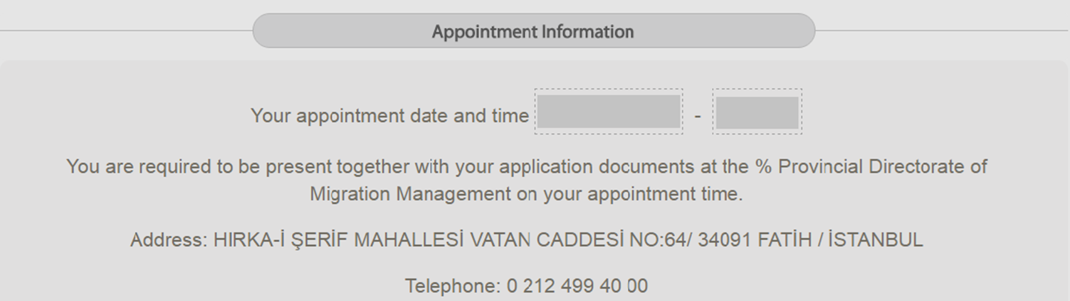
Click “PRINT APPLICATION”
(it saves it to your PC as pdf and
you may print it out
after that
Also you can send that pdf to your own e-mail address.)
“
Remember, regardless of your appointment date,
we will have the appointment procedure done in
Santral Campus.
THAT IS WHERE & WHEN YOU WILL SUBMIT EVERYTHING!
The Collective Application will take place at SANTRAL campus, in the white tent,
October 16th-17th, 2018 between 09:00am-17:00pm.
”
Notes:
Bunun için bilgi bekliyoruz göç idaresinden

Slide 15
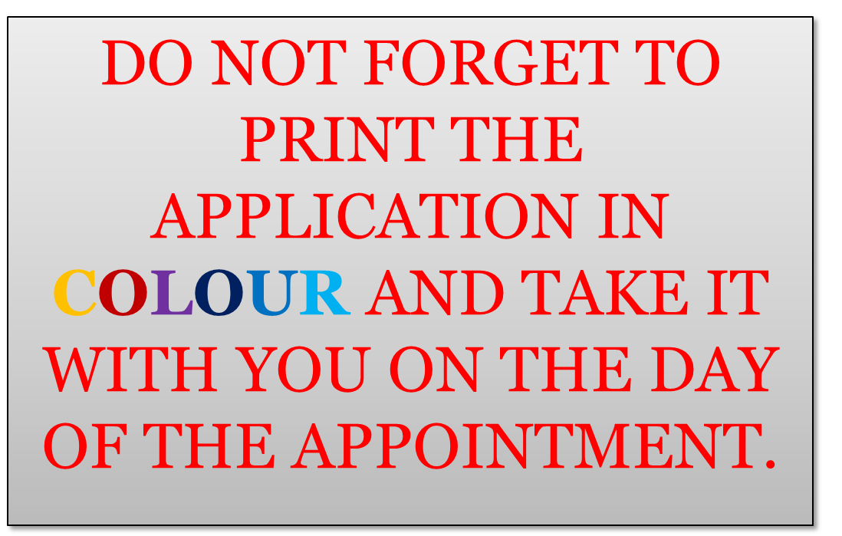
“
”

Slide 16
Statement of Income
*It is in your welcome pack.
You can also receive it from International Center.
İSTANBUL GÖÇ İDARESİ MÜDÜRLÜĞÜNE
“
nationality
passport number
……Alman….. uyruklu olup…34573XXXXX.. Numaralı pasaport sahibiyim. İstanbul’da……İstanbul Bilgi…… üniversitesinde öğrenciyim. Türkiye’de öğrenci olduğumdan herhangi bir yerde çalışmamaktayım ve Türkiye’de ailemin maddi yardımıyla geçimimi sağlamaktayım. Almış olduğum öğrenim amaçlı randevumla işlemlerimin yapılıp tarafıma oturma izni verilmesini istiyorum. Vermiş olduğum bilgilerin doğruluğunu kabul eder ve gereğinin yapılmasını arz ederim.
AD : Your NAME
SOYAD : Your SURNAME
TEL : Phone number
İMZA : Signature
”

Slide 17
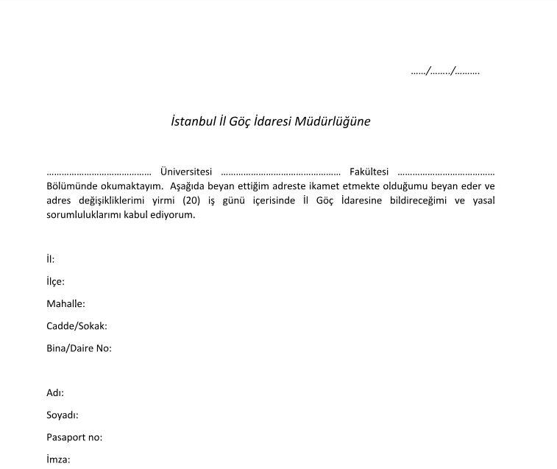
Address Information
*It is in your welcome pack. You can also require it from International Center.
Please write down our santral Campus’s address with the receiving name as Istanbul Bilgi University International Center.
“
Date : Day/Month/Year
İstanbul Bilgi Üniversitesi
Faculty Name at BILGI
Turkish Name of the Major
İstanbul
Eyüp
Emniyettepe Mah.
Eski Silahtarağa Elektrik Santralı , Kazım Karabekir Cad.
No: 2 /13
Name
”
Surname
Passport Number
Signature

Slide 18
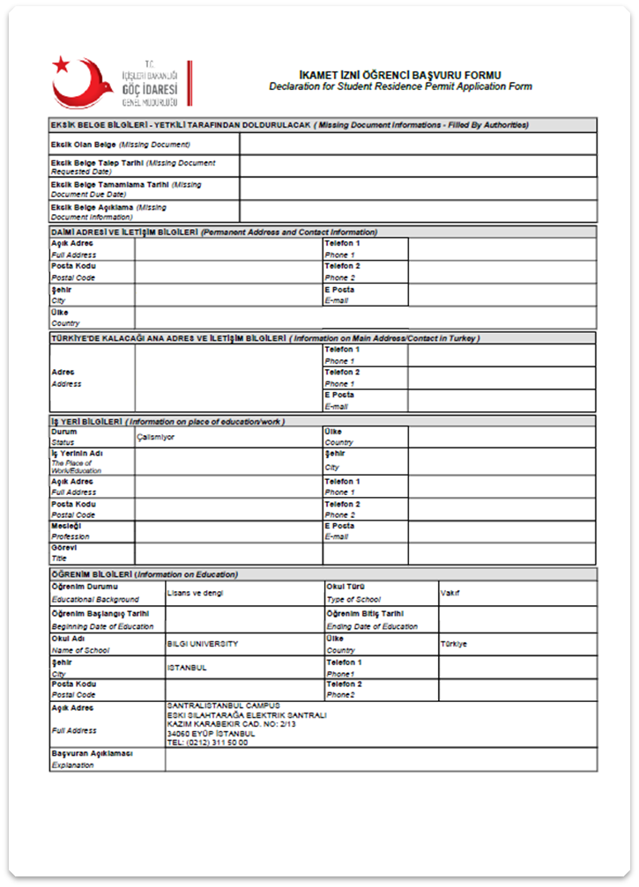
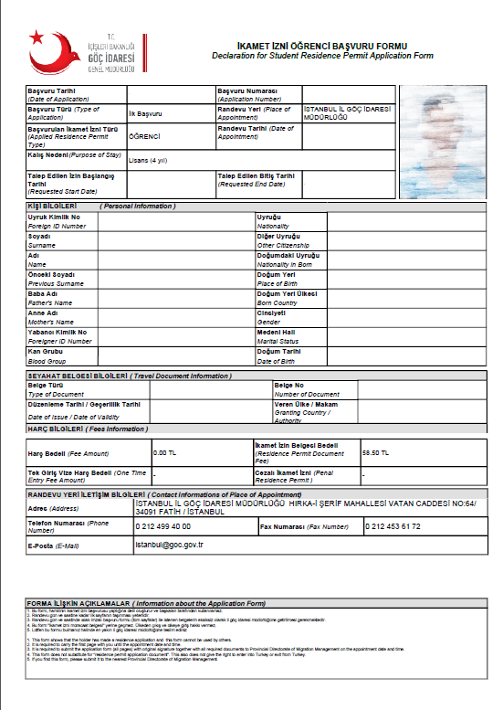
“
”

Slide 19
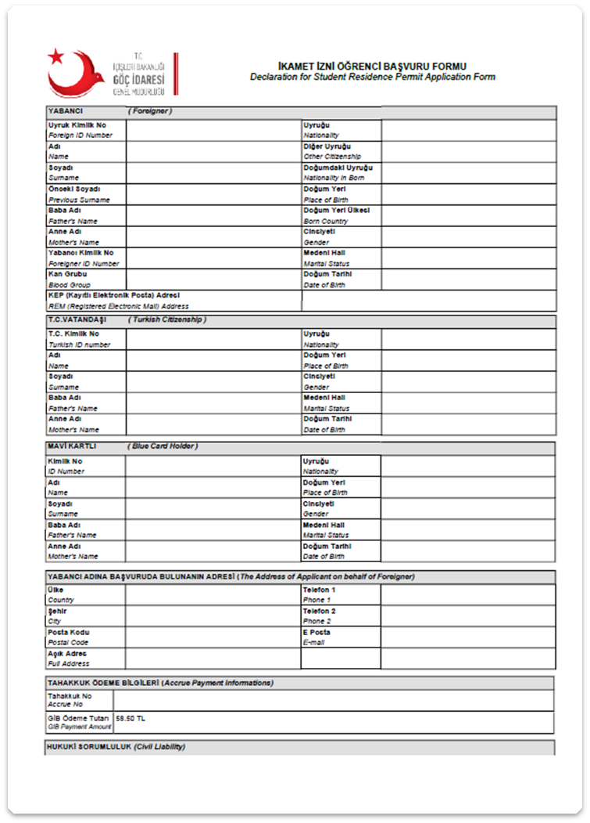
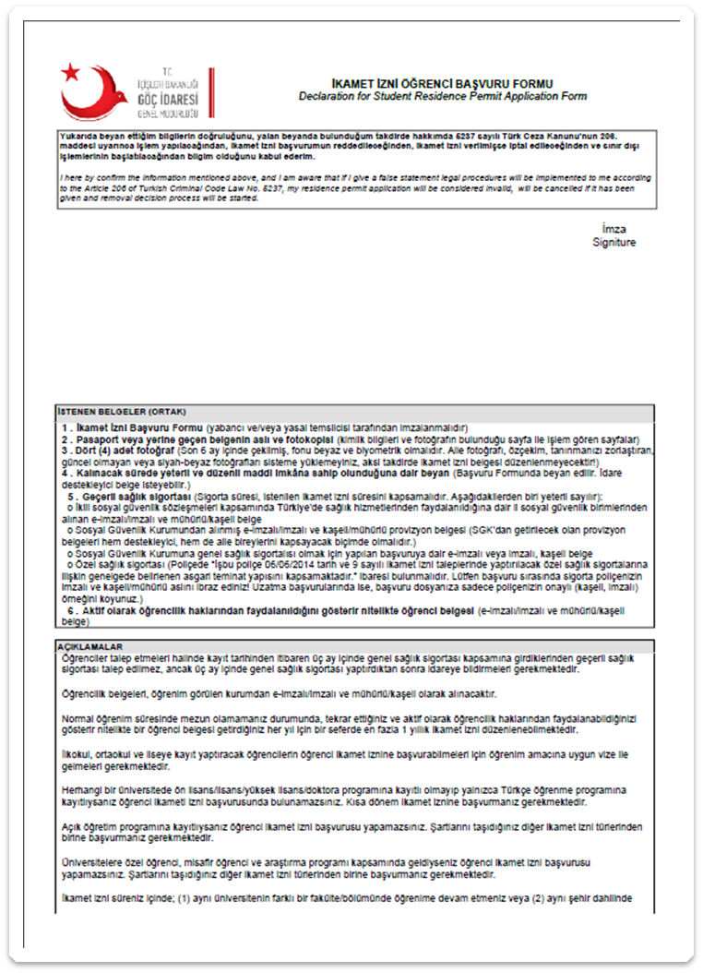
“
SİGN HERE
”

Slide 20

LEAVING TURKEY BEFORE RECEIVING THE RESIDENCE PERMIT
A student visa only allows you one entry into Turkey, meaning you cannot leave Turkey until you receive the residence permit.
In case you decide to leave Turkey and take the risk before you receive the residence permit, please make sure you have your residence permit receipt with you at the airport that shows you applied for your residence permit and are waiting to receive it.
The International Center suggests you don’t take this risk and you wait until you receive your resident permit before you travel outside of Turkey.
After the submission please be sure that you have got your «Müracaat Belgesi» It is the receipt of residence permit application.
In case you decide to leave Turkey before you receive the residence permit, please make sure you have your Müracaat Belgesi + residence payment receipt with you at the airport that shows you applied for your residence permit.
According to the law, you are NOT allowed to leave the country more than 15 days without the residence permit.

Slide 21
EXTENDING YOUR PERIOD OF STAY
Foreign students finishing their education at Istanbul Bilgi University are obliged to leave the country right after their semester ends.
In case you would want to stay in Turkish borders for a longer period of time you have to inform Migration Office about this fact in a short time.
Extension of Student Residence Permit: http://bit.ly/2oIpFjJ
Notes:
Bu kalmalı mı?

Slide 22
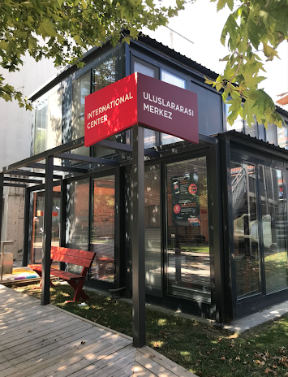


And don’t forget,
International Center is always here to help you.
International Center Building,
Erasmus Office , Santral Campus

Slide 23
Facebook Private Group: https://www.facebook.com/groups/Erasmus.BilgiUniversity/
Instagram: @bilgi_internationalcenter
Email: erasmus@bilgi.edu.tr – gozde.topraktepe@bilgi.edu.tr

Slide 24
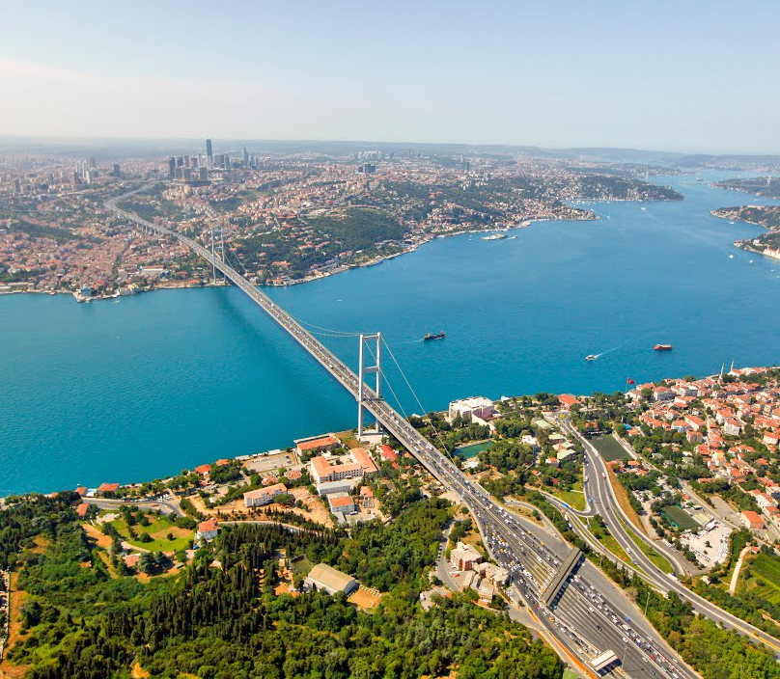
Final thought from the
Erasmus Office:
Enjoy İstanbul!
“
”

Slide 25
THANK YOU FOR YOUR ATTENTION!
WE WISH YOU A GOOD SEMESTER!

