Slide 1
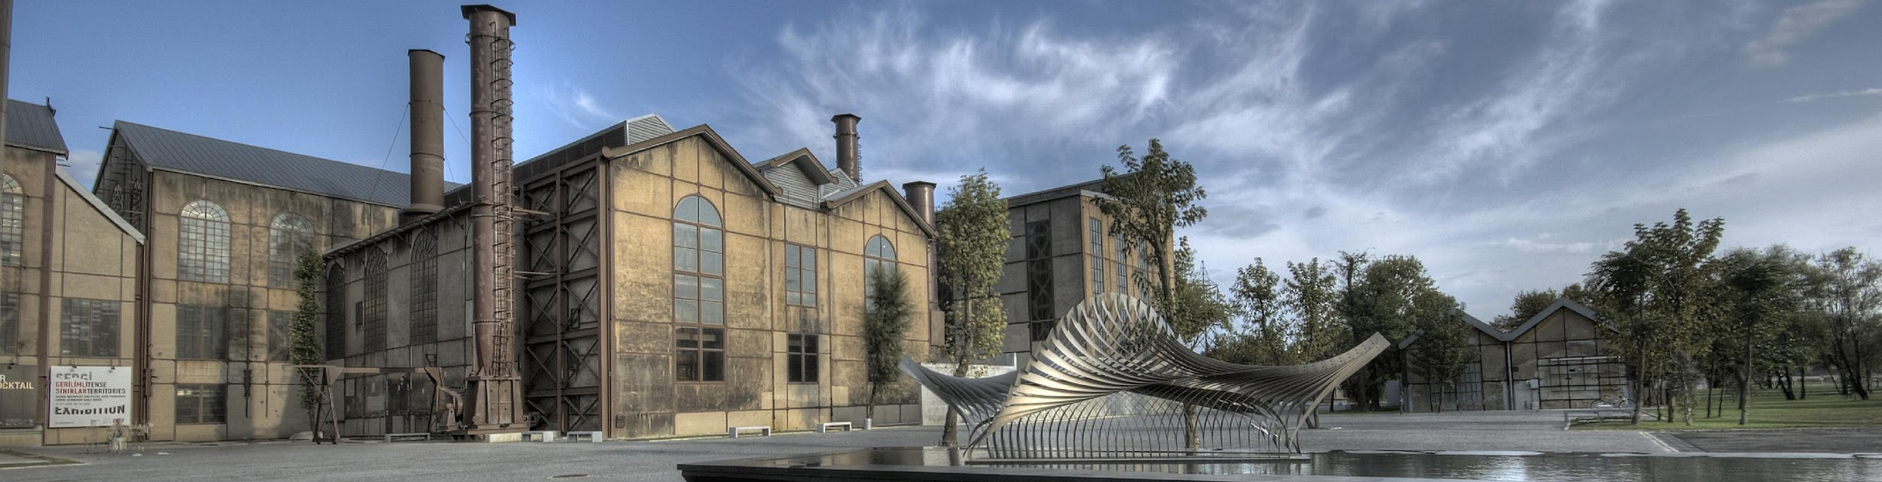
COURSE REGISTRATION
Student Affairs
International Student Advising Office

Slide 2







Things to know step by step:
Appointment
for course registration
How to do
my course registration?
Approval
for course registration
Keywords
for course registration
Add-Drop
Withdrawal
Section Change

Slide 3

You should make your course registration between
September 26-30

Slide 4

Be careful about the following issues
during your course registration

Slide 5
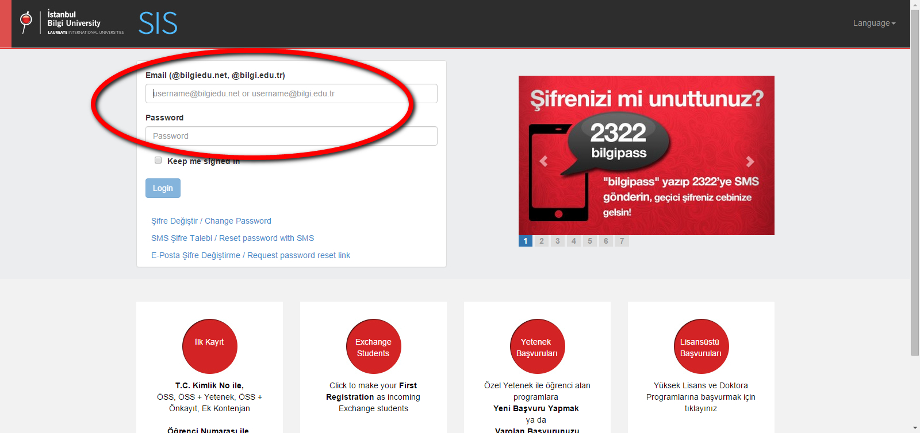
“
Go to sis.bilgi.edu.tr
and log in with your BİLGİ e-mail
”

Slide 6

APPOINTMENT FOR COURSE REGISTRATION
You should first schedule an appointment for course registration.
Online appointment can be made on SIS website and will be open on September 19, 2022 at 11:00 am .
You can make your appointment online in just 3 simple steps.

Slide 7
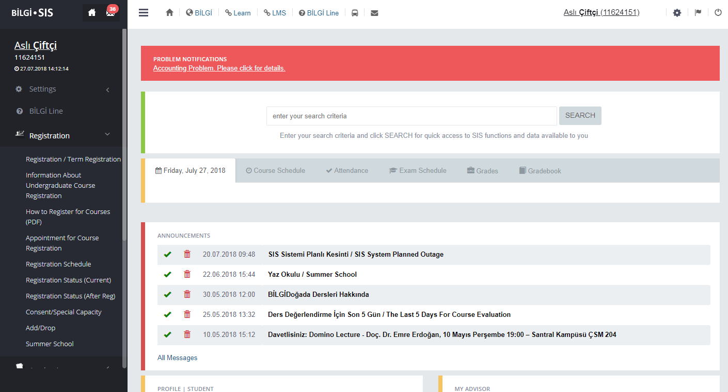
Click on 'Registration'
“
”

Slide 8
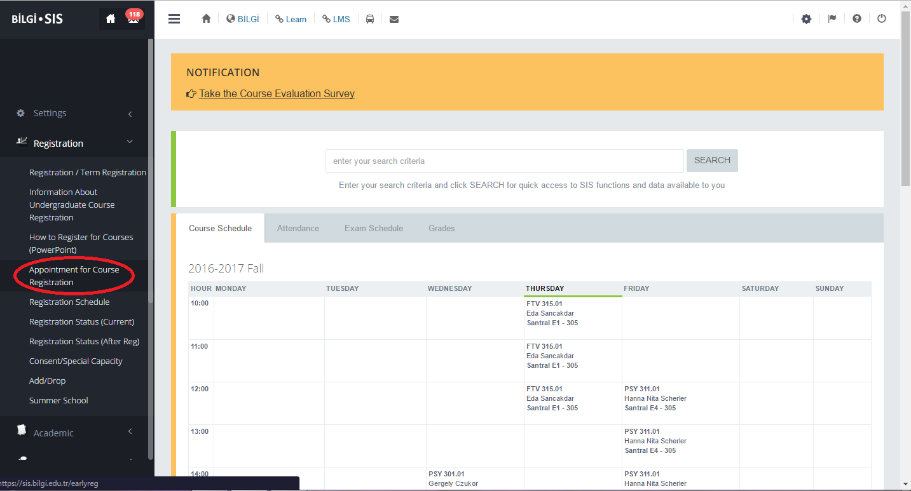
Click on
'Appointment for Course Registration'
“
”

Slide 9
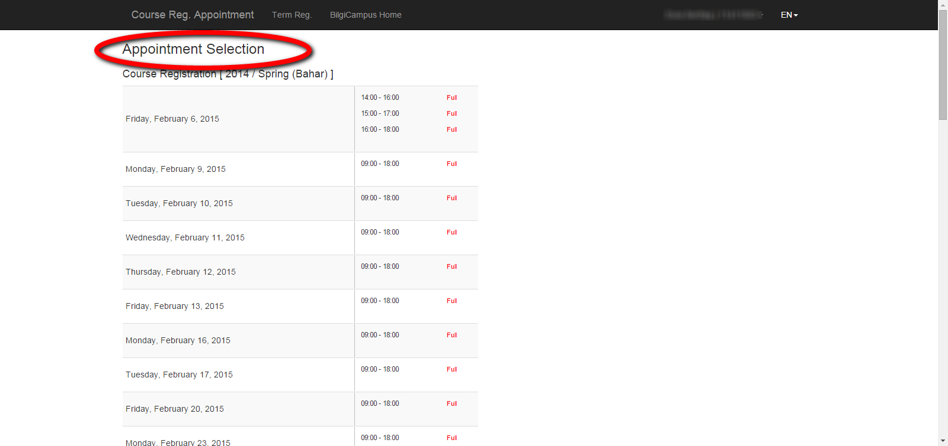
Select a time slot
“
”

Slide 10
THINGS TO DO BEFORE COURSE REGISTRATION
Please plan your courses first by looking at the course catalogue.
If you take a course with consent or special capacity, get your approval from the instructor of the course.
Please make alternative list of courses in case there is a seat capacity problem with the course that you have selected.
You may find the contact information of your advisor or instructor on http://rehber.bilgi.edu.tr

Slide 11
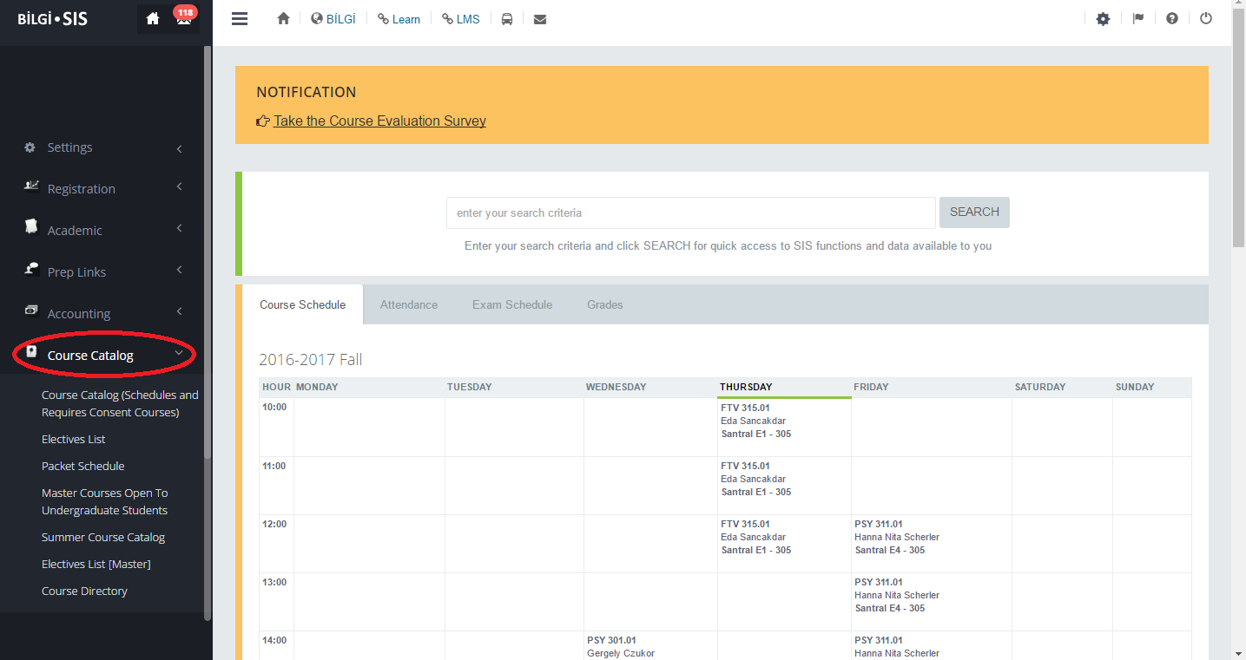
Click on 'Course Catalog'
https://ects.bilgi.edu.tr/Department/PacketSchedule
“
”

Slide 12
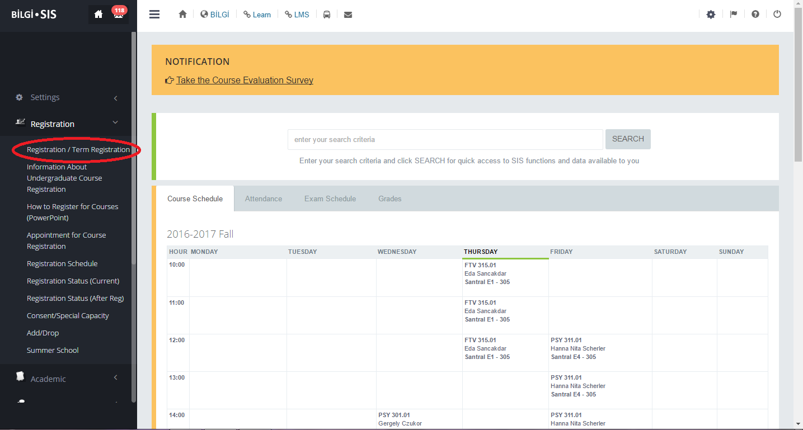
COURSE REGISTRATION
Click on 'Term Registration'
“
”

Slide 13
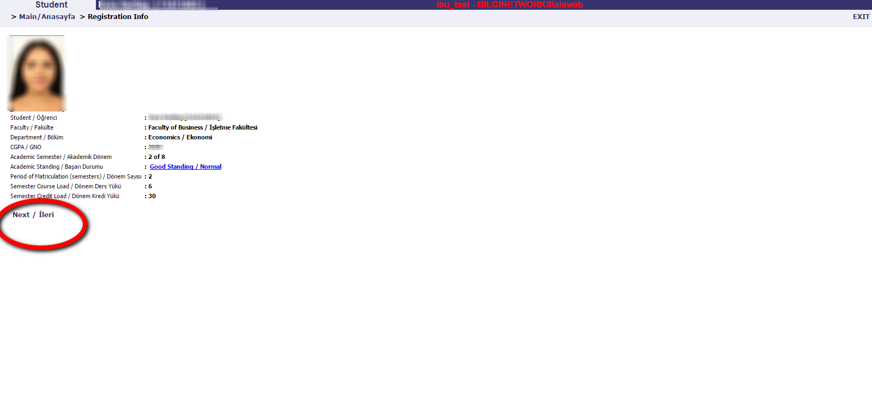
You can see your personal information, credit load, and your current academic semester.
You can see the courses that you have taken with consent or special capacity.
Click 'next' to continue.
“
”

Slide 14
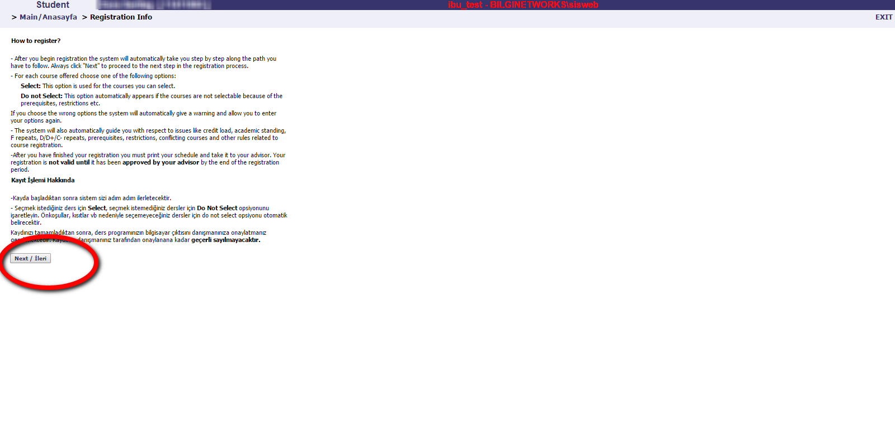
Please read carefully.
Click 'next' to continue.
“
”

Slide 15
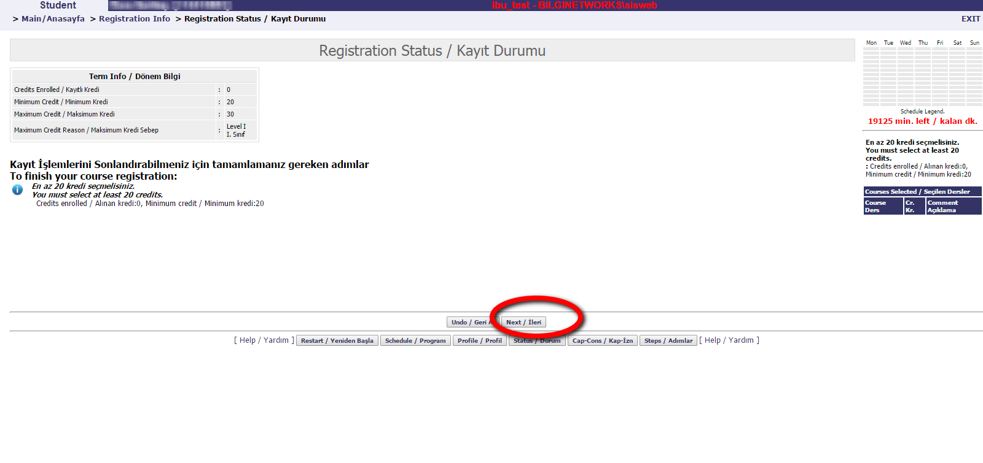
You can see your semester credit load.
Click 'next' to continue.
“
”

Slide 16
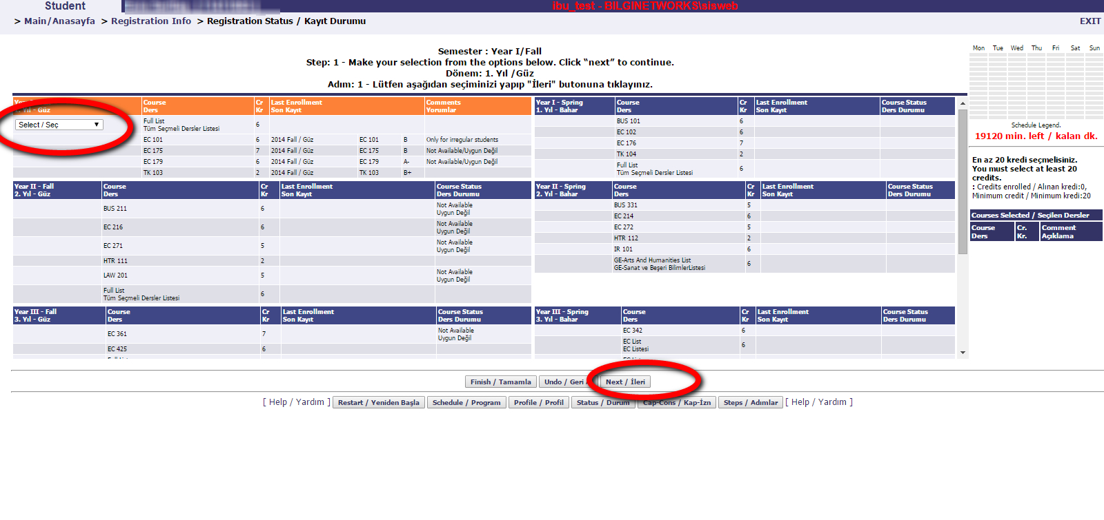
Make your selection from the options.
Click 'next' to continue
“
”

Slide 17
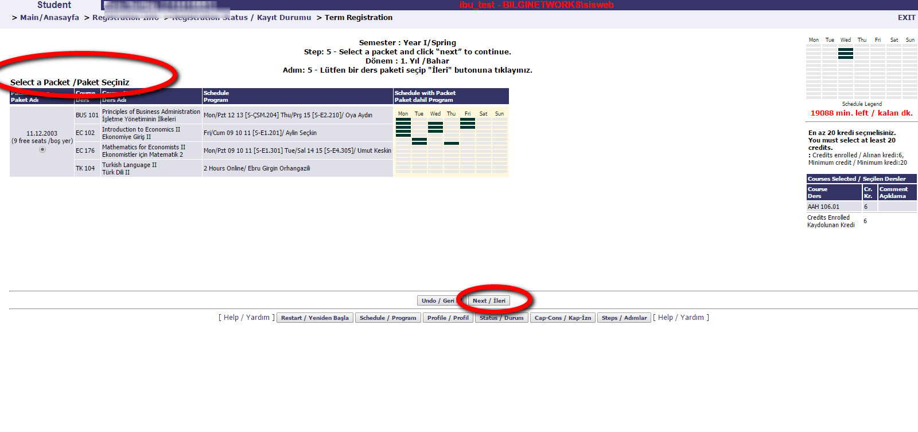
Select a packet.
Click 'next' to continue.
“
”

Slide 18
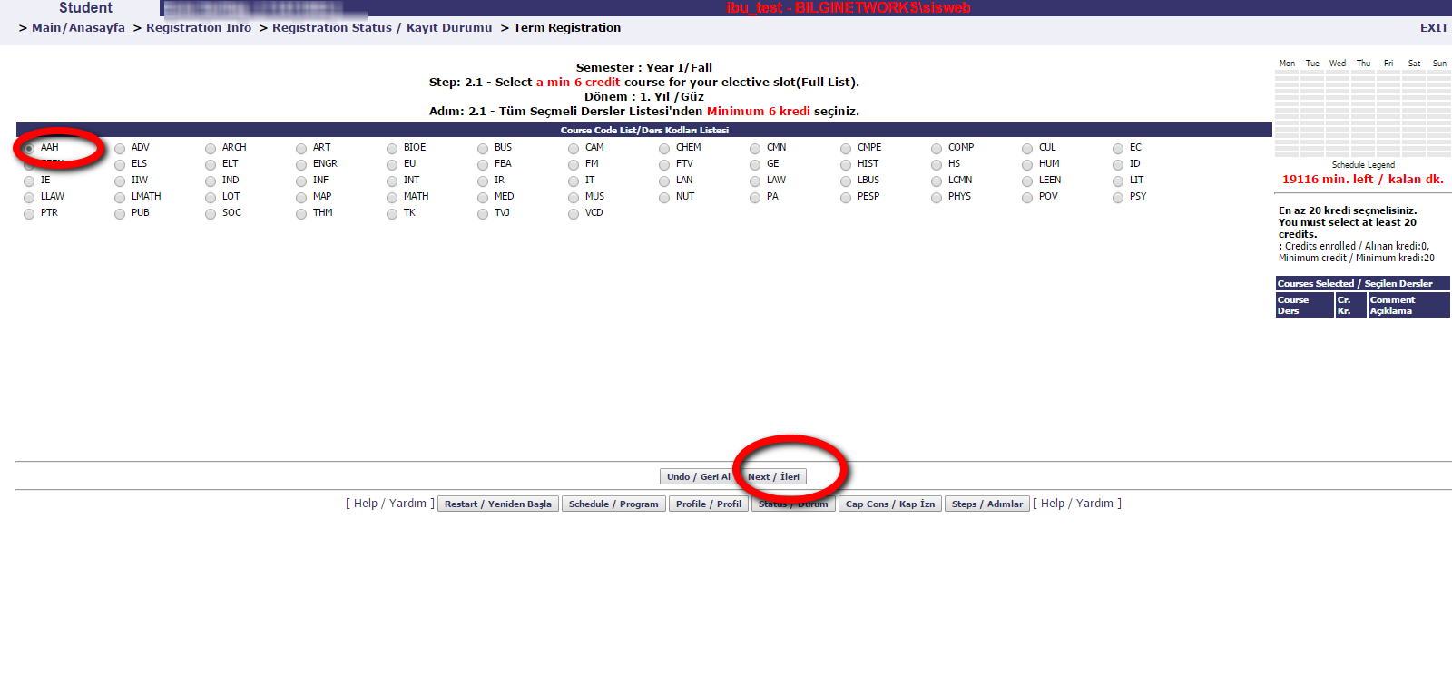
“
Choose a course for your elective slot under the related program.
Click 'next' to continue
”

Slide 19
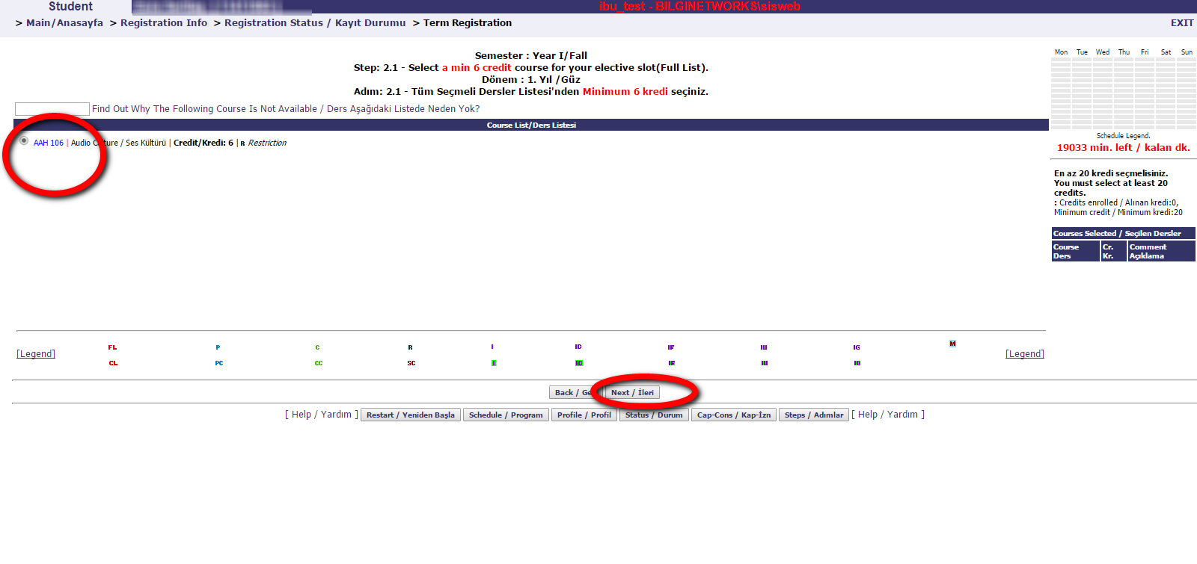
“
You can see the course that
you have selected.
Click 'next' to continue.
”

Slide 20
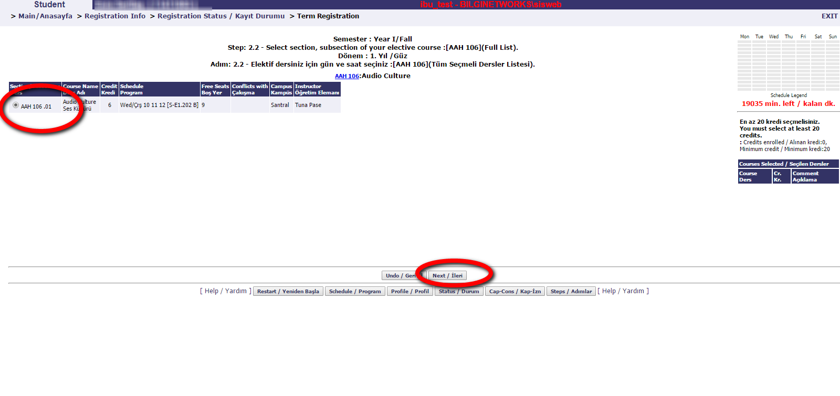
“
You can see the instructor, campus, and free seat information regarding the course. You can also see whether the course conflicts with another course that you have selected.
Click 'next' to continue.
”

Slide 21
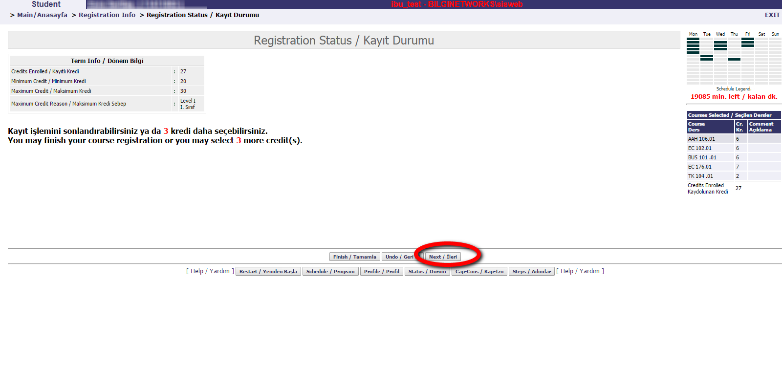
You can finish your registration.
Click ‘next’ to continue
OR if you would like to make any changes, you can click on ‘Undo’ button.
If you would like to make your course registration from the beginning, then please use ‘Restart’.
“
”

Slide 22
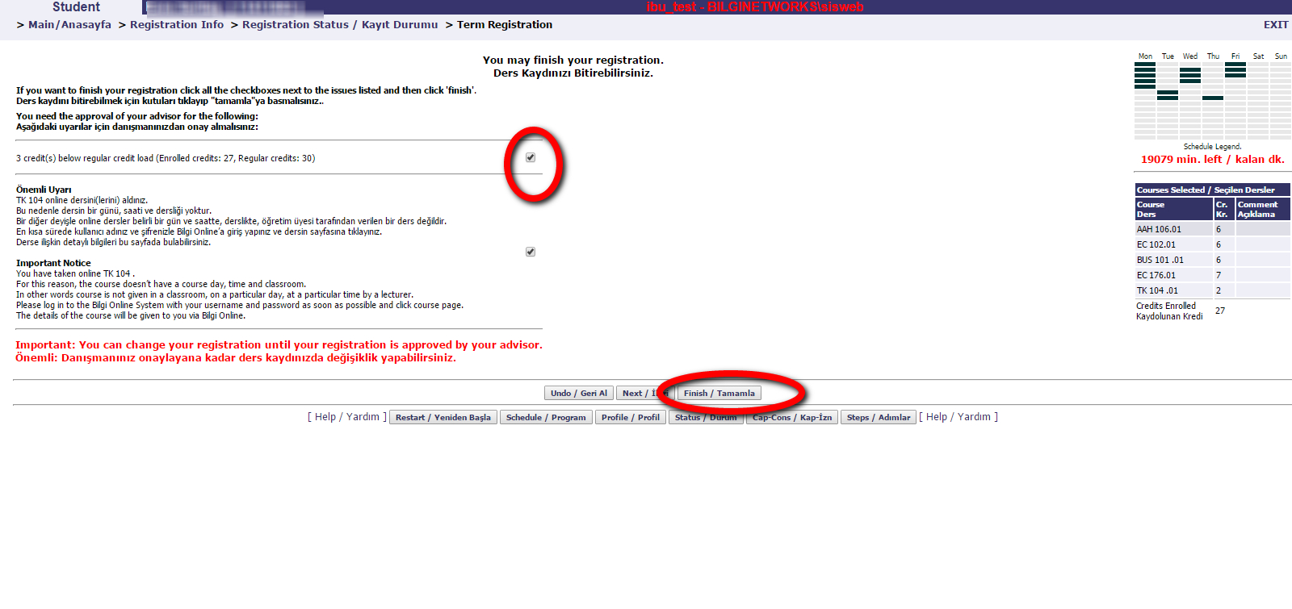
You can finish your registration.
Please read the information carefully!!!
Click on Checkboxes.
Click on Finish.
“
”

Slide 23
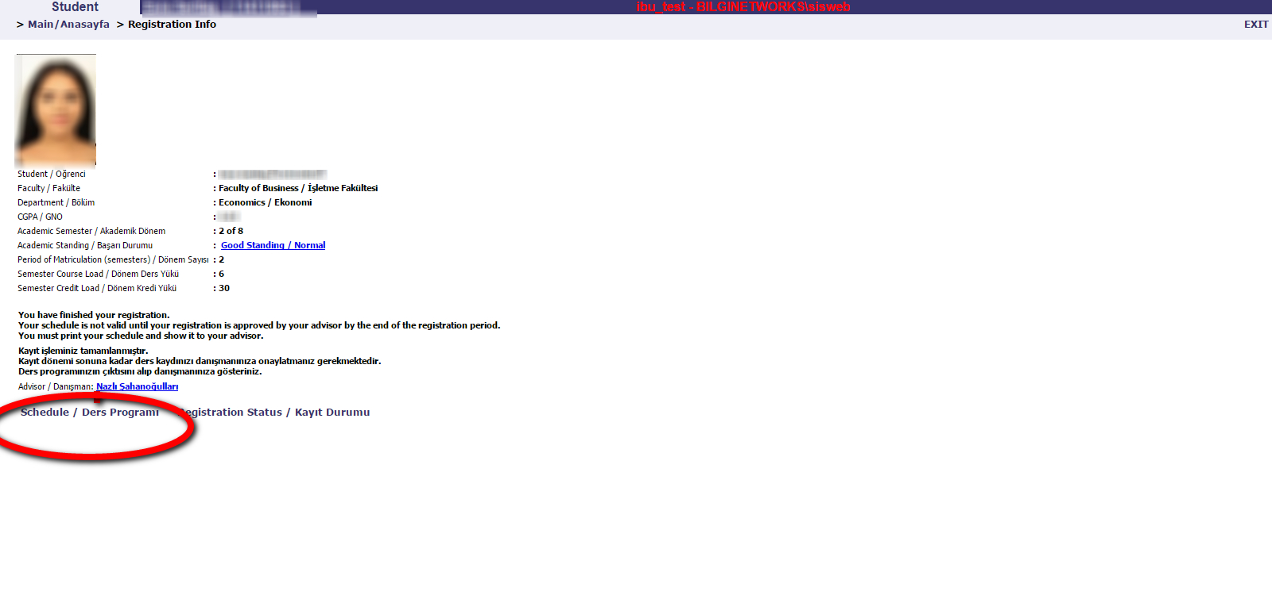
You can see your schedule and your registration code under ‘Schedule’.
“
”

Slide 24
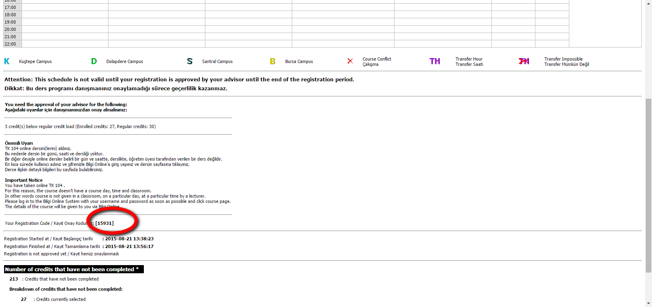
Your schedule is not valid until your registration is approved by your advisor until the end of the registration period. Your advisor will approve your registration with your registration code. Please send your registration code as an e-mail to your advisor.
“
”

Slide 25
IF YOU CLICK ON FINISH BUTTON AND FINALIZE YOUR REGISTRATION YOU CAN RETURN TO THE SYSTEM
TO CHANGE YOUR COURSES (IF IT HAS NOT BEEN APPROVED BY THE ADVISOR YET).
STEPS FOR EDITING COURSES
Click ‘Term Registration’
Enter your registration code to restart your course registration.
When you complete your selection, click the finish button and get your registration code approved by your advisor.

Slide 26
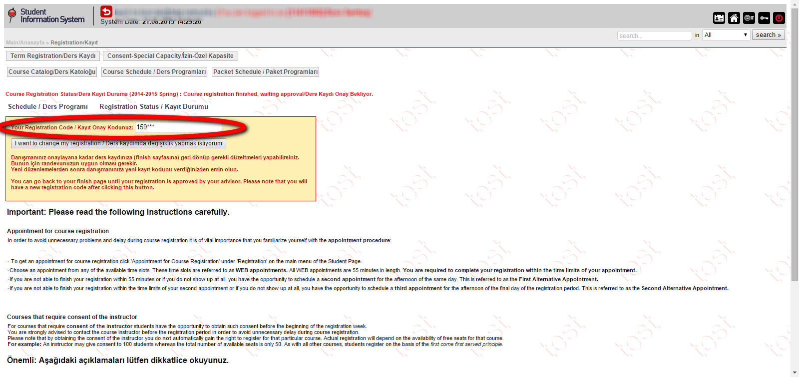
Click ‘Term Registration’ and enter your registration code
to restart your course registration.
“
”

Slide 27
ADD-DROP
You can change your elective courses only during the add-drop period from your student’s personal page (SIS) under the add-drop link between
October 10-12

Slide 28

SECTION CHANGE
You can change the class hours with an alternative one (if available) from your student’s personal page (SIS) under the section change part.
The duration of section change is for 2 weeks after the add-drop period.

Slide 29

WITHDRAWAL
You can withdraw from any of your elective courses from your student’s personal page (SIS) under the withdrawal request link until December 9, 2022.

Slide 30
HOW CAN I APPLY FOR STUDENT CERTIFICATE?
Visit İstanbul Bilgi University website and make an application through SIS/Student Pages.
After completing the application, you will receive the student certificate in your BİLGİ e-mail account with an e-signature.
Your student certificate will be ready in (1) working day.
Please note that you can request your certificate both in Turkish and in English.
There is a note section and you can add your personal notes.

Slide 31
“
Go to https://sis.bilgi.edu.tr/
and log in with your BİLGİ e-mail
”

Slide 32
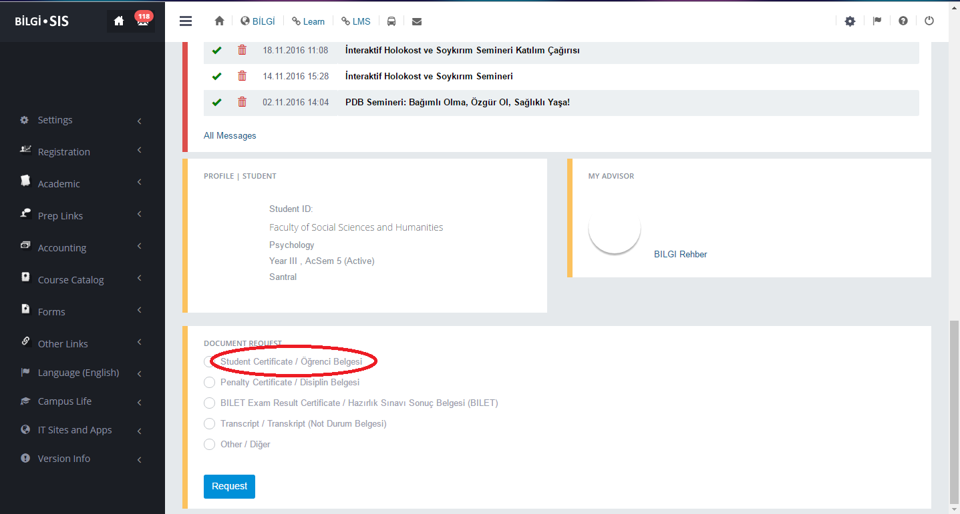
Select ‘Student Certificate’
and click request.
“
”

Slide 33
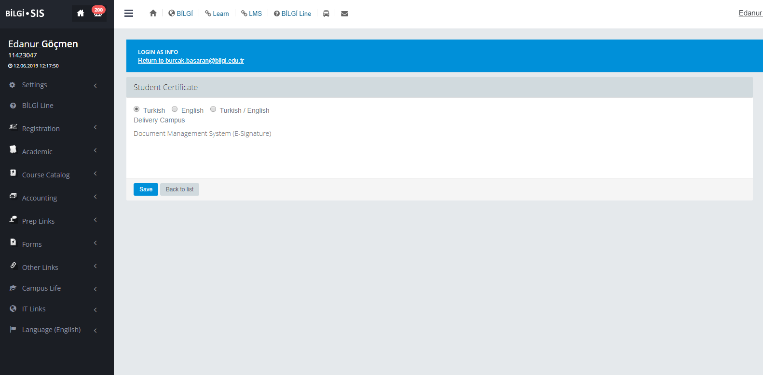
Decide whether you need your certificate in “Turkish” Or in “English”, then continue with ‘Save/Kaydet.’
“
”

Slide 34
HOW CAN I APPLY FOR A TRANSCRIPT?
Please follow the same steps that are valid for student certificate application.
Go to İstanbul Bilgi University website and make an application through SIS/Student Pages.
After completing the application, you will receive the transcript in your BİLGİ e-mail account with an e-signature.
Your student transcript will be ready in (2) working days.

Slide 35
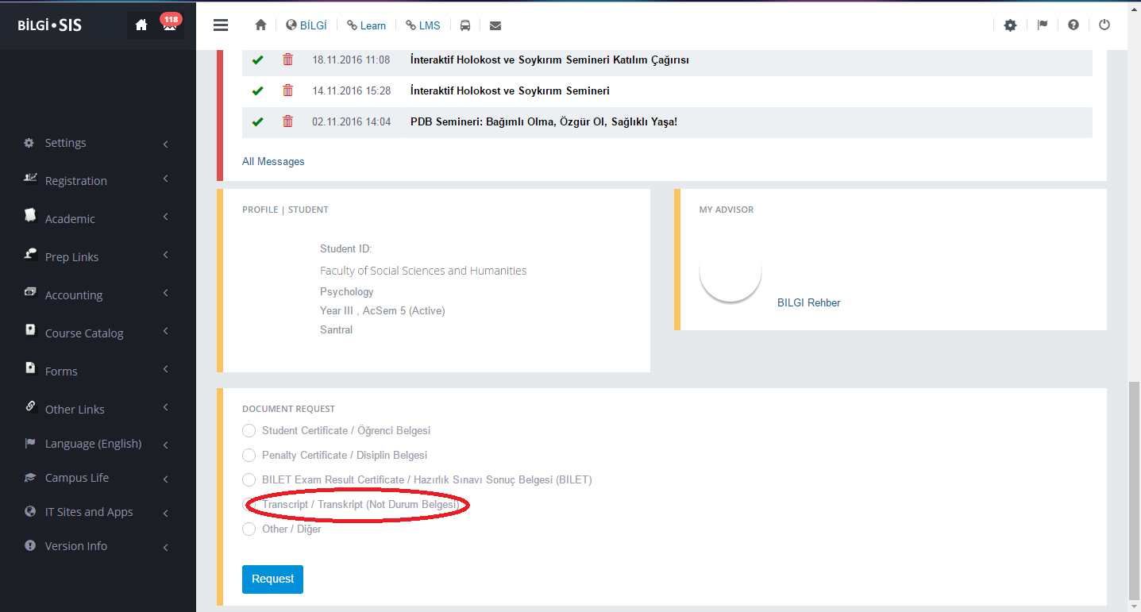
Select ‘Transcript’ and
Click on request.
“
”

Slide 36
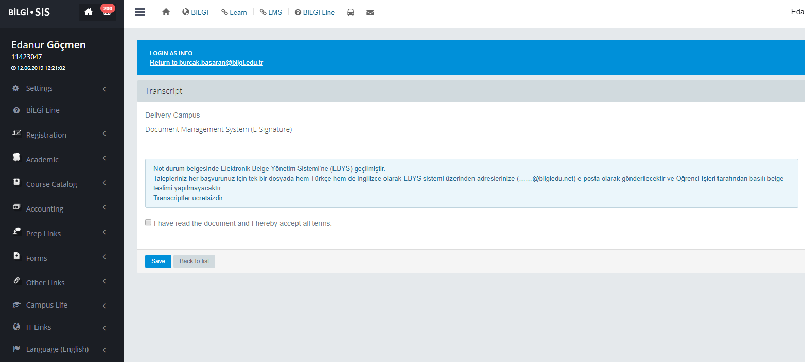
Your transcript will be prepared both in Turkish and in English separately.
As they are e-signed, there is no fee.
Check the box to accept the terms and click on ‘Kaydet/Save.’
“
”

Slide 37
Student Affairs
santralistanbul Campus
ÇSM Ground Floor – Z-112
Kuştepe Campus
Block A – 204
Dolapdere Campus
DYB - 314

Slide 38
WISHING YOU A SUCCESSFUL SEMESTER!

