Slide 1
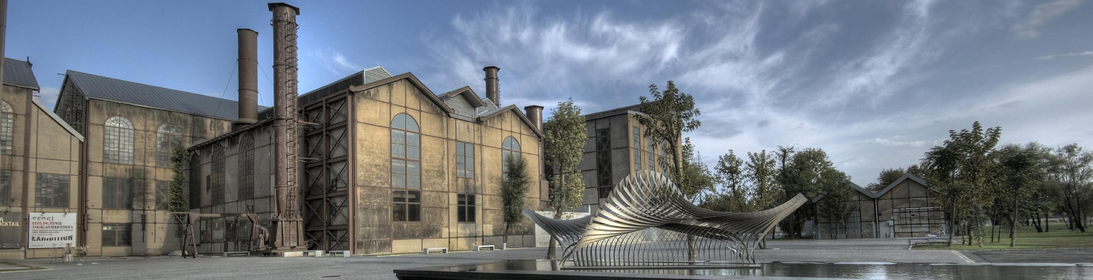
COURSE REGISTRATION
Graduate Student Affairs

Slide 2




Things to know step by step:
How to do
my course registration?
Approval
for course registration
Add-Drop
Withdrawal

Slide 3

You should make your course registration between
February 12-16,2024.

Slide 4

Things to consider
during your course registration

Slide 5
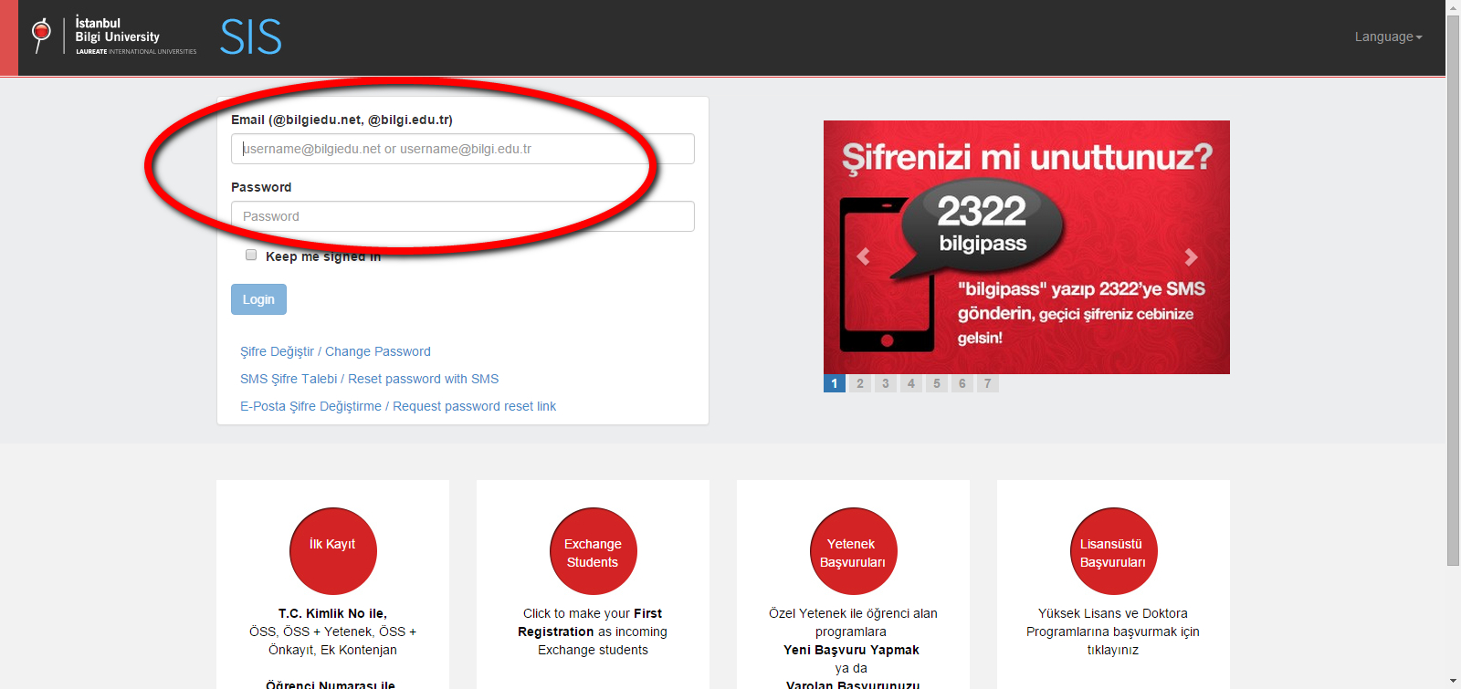
“
Go to sis.bilgi.edu.tr
and log in with your BİLGİ email
”

Slide 6
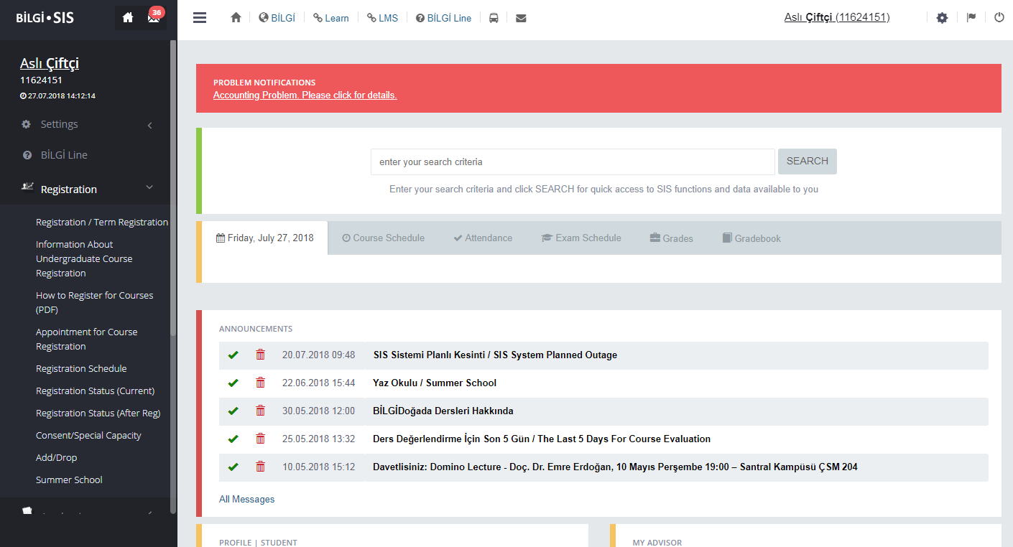
Click on ‘Registration’
“
”

Slide 7
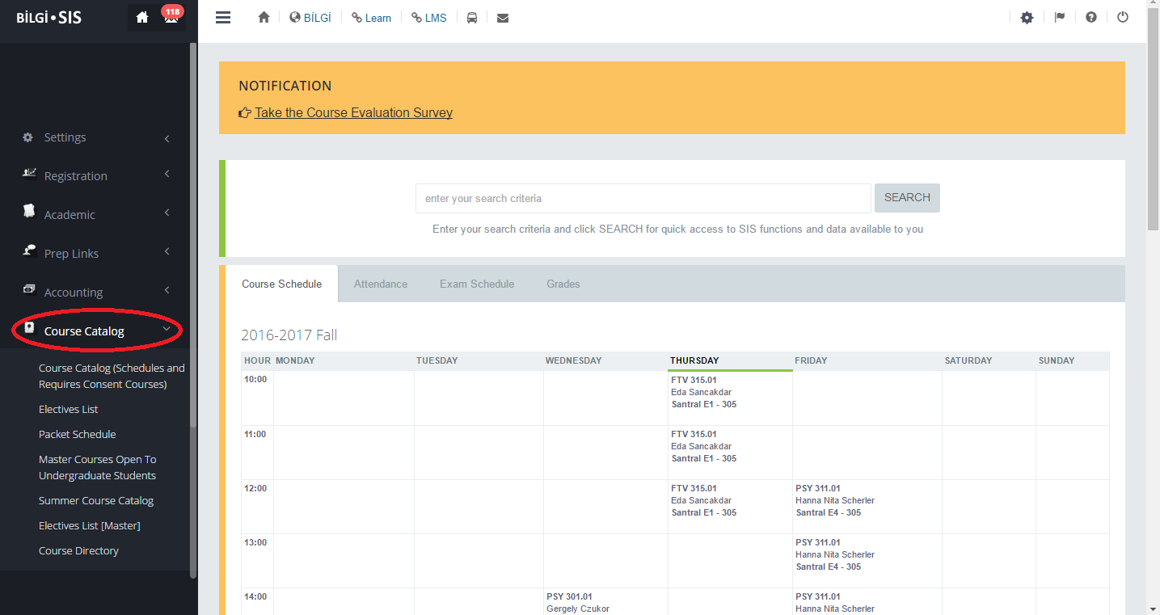
Click on ‘Course Catalog’
https://ects.bilgi.edu.tr/Department/PacketSchedule
“
”

Slide 8
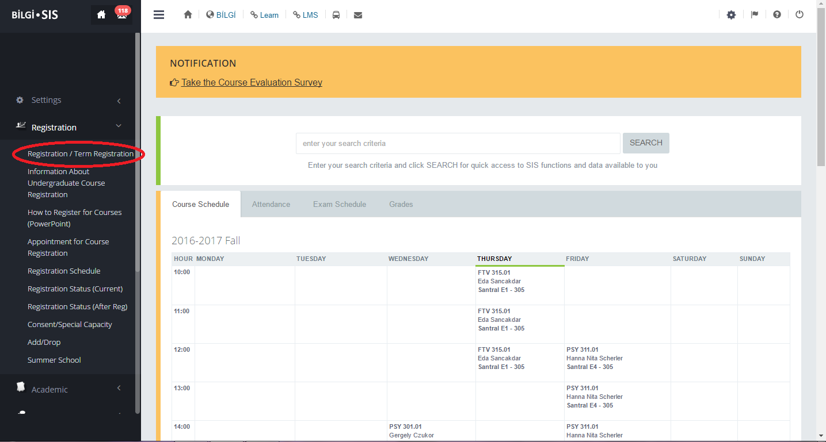
COURSE REGISTRATION
Click on ‘Term Registration.’
“
”

Slide 9
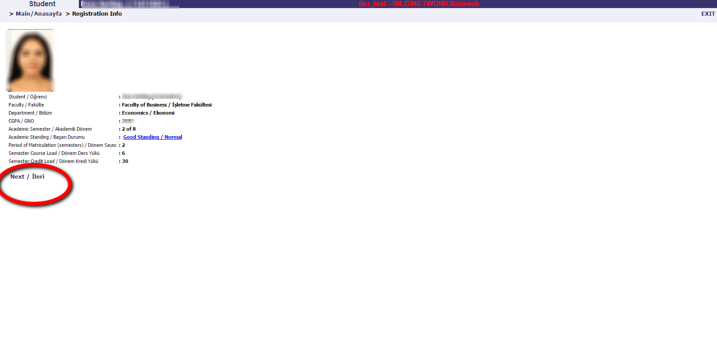
You can view your personal information, credit load, and academic semester.
You can view courses for which you have obtained consent or have special capacity.
Click ‘next’ to continue.
“
”

Slide 10
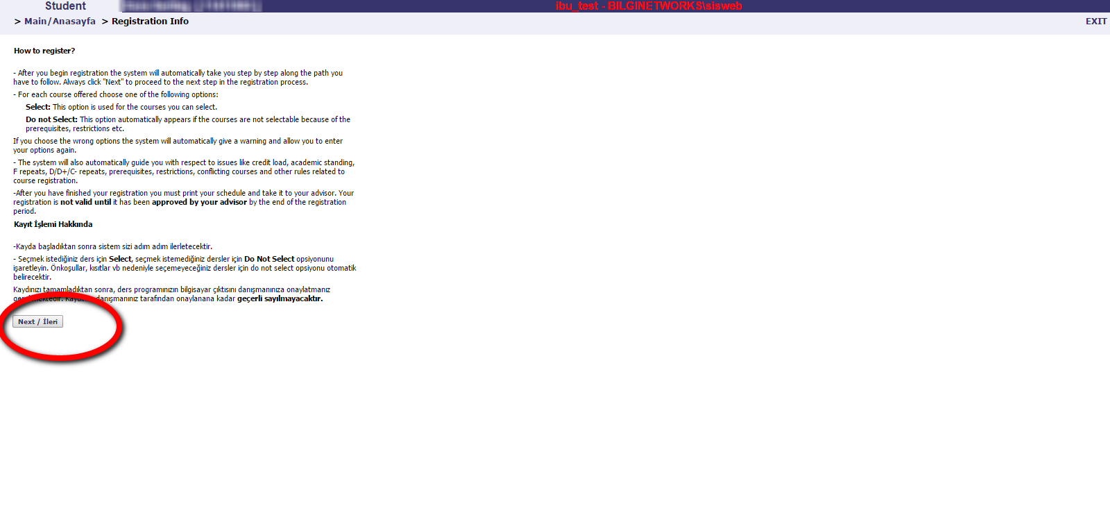
Please read carefully.
Click ‘next’ to continue.
“
”

Slide 11
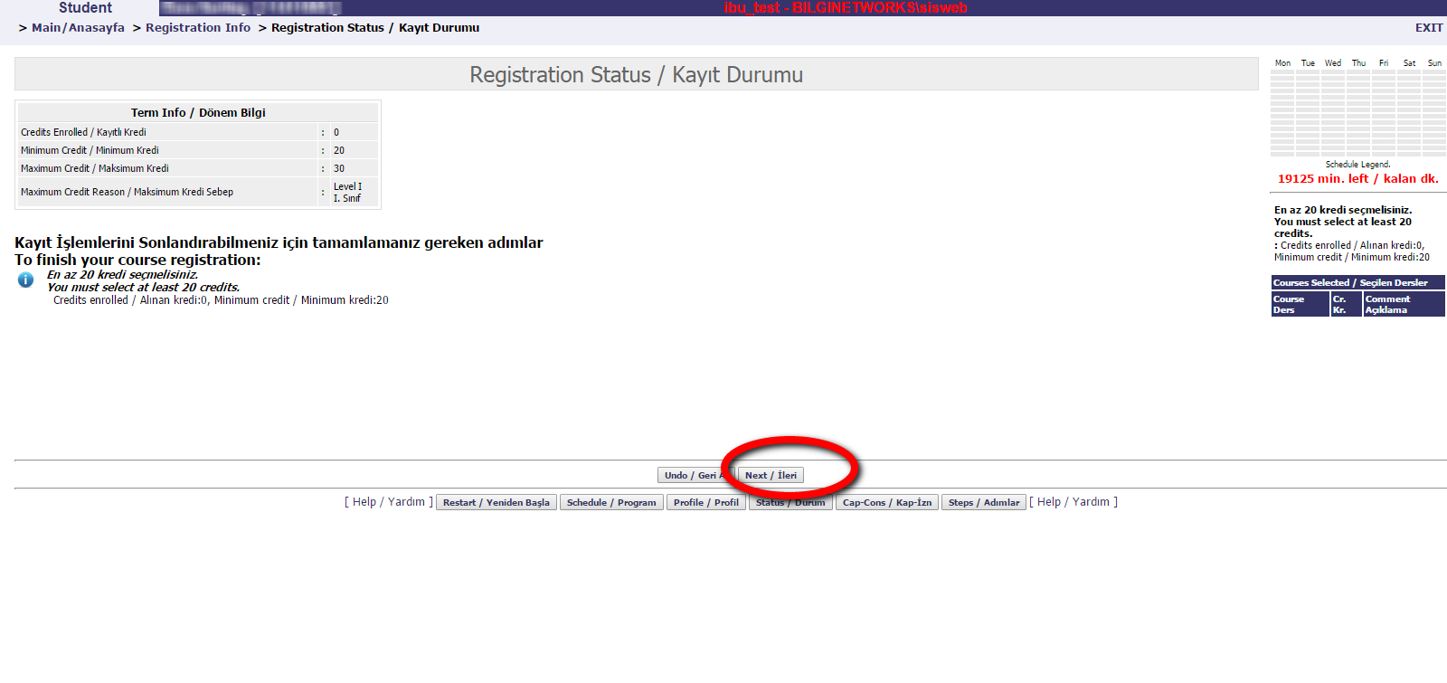
You can view your semester credit load.
Click ‘next’ to continue.
“
”

Slide 12
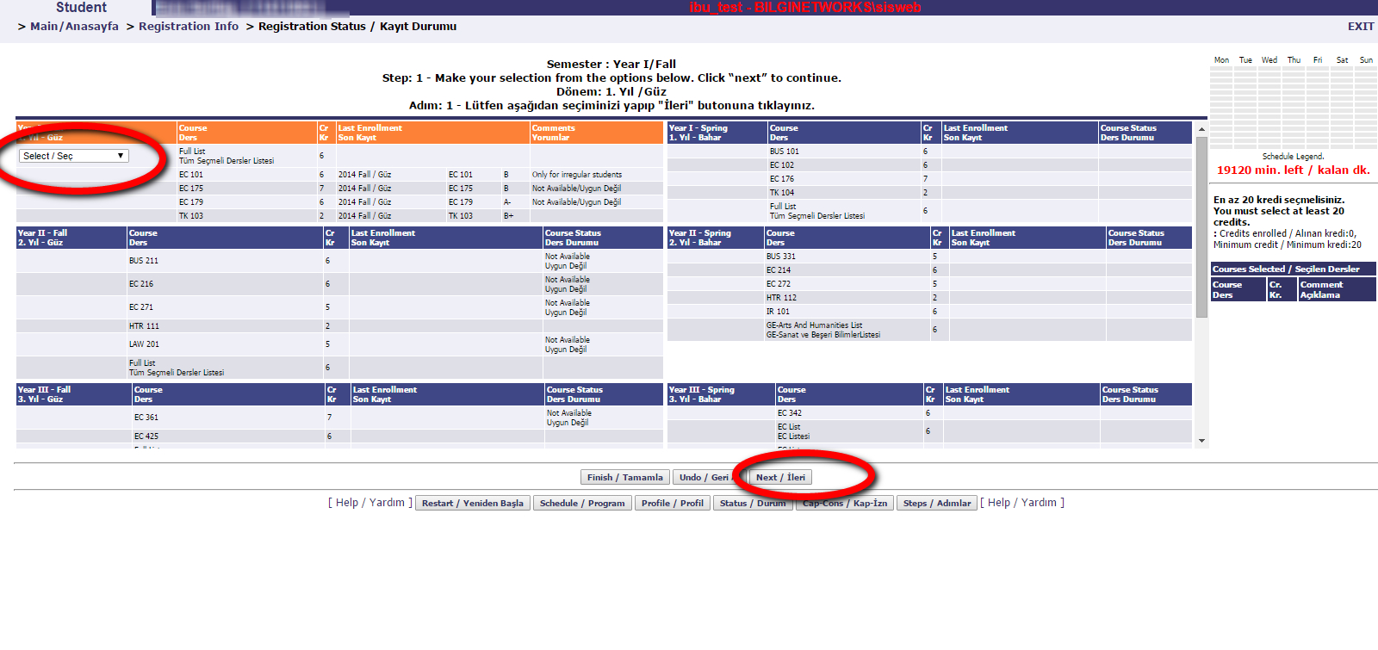
Make your selection from the options.
Click ‘next’ to continue
“
”

Slide 13
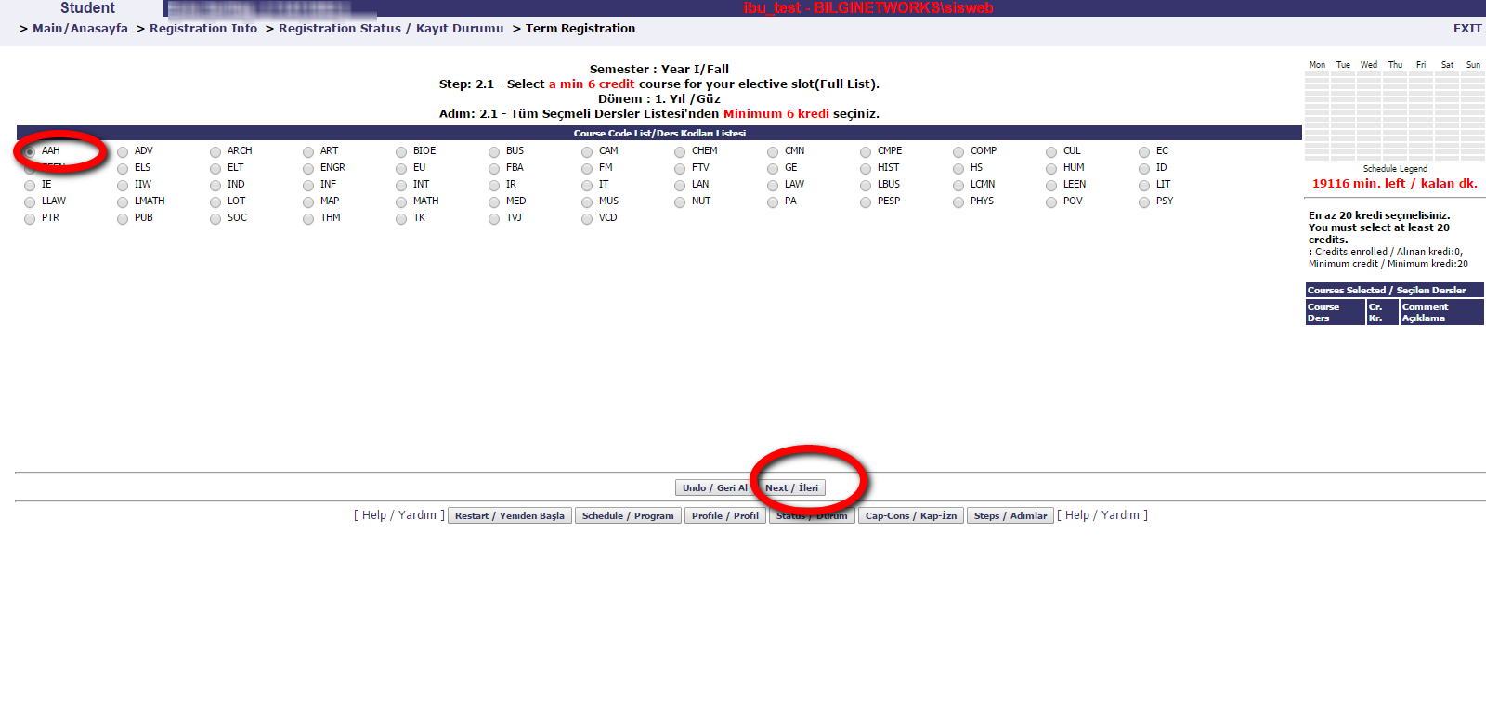
“
Choose a course for your elective slot under the related program.
Click ‘next’ to continue
”

Slide 14
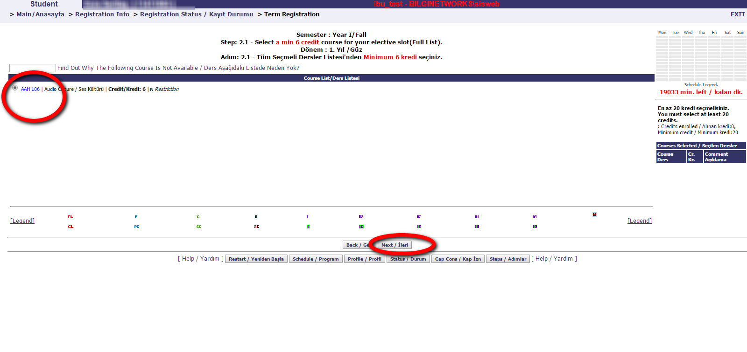
“
You can view the course
you have selected.
Click ‘next’ to continue.
”

Slide 15
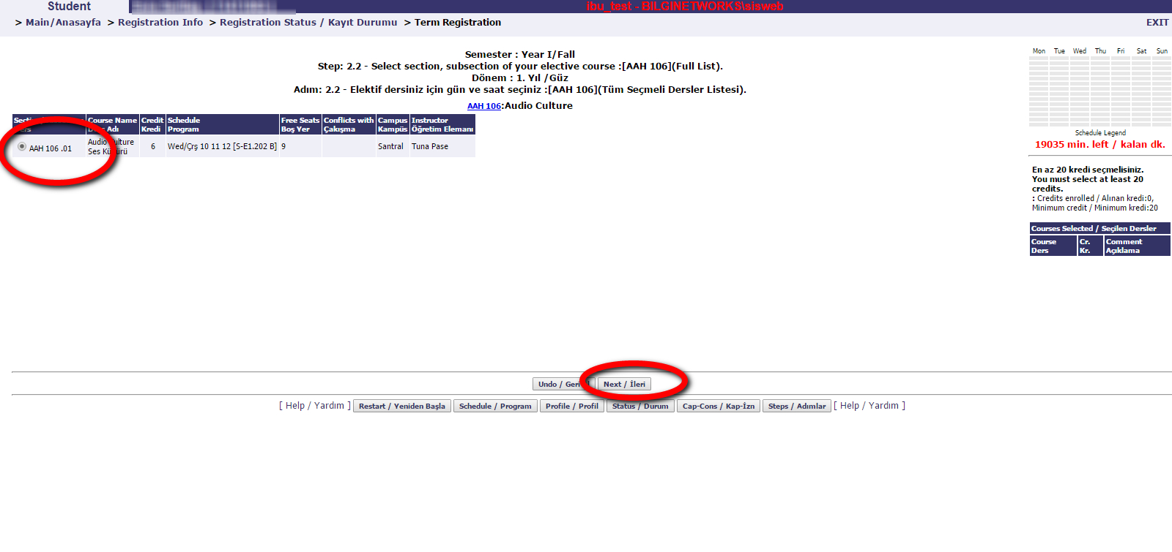
“
On the opening screen, you can view the instructor, campus, free seat information and you can also view whether the class conflicts with another class you have selected.
Click ‘next’ to continue.
”

Slide 16
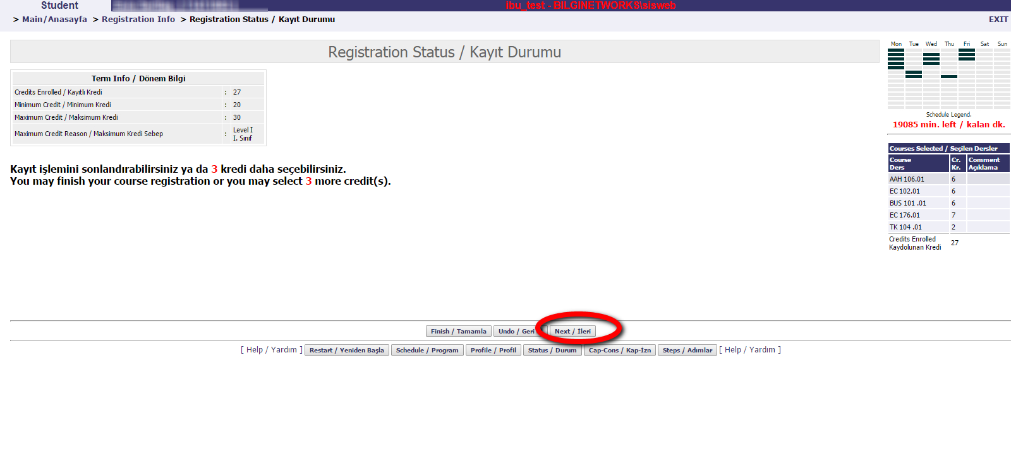
You can finish your registration.
Click next to continue
OR, if you would like to make any changes, you can click on ‘Undo’ button.
If you would like to do your course registration from the beginning, then please use ‘Restart.’
“
”

Slide 17
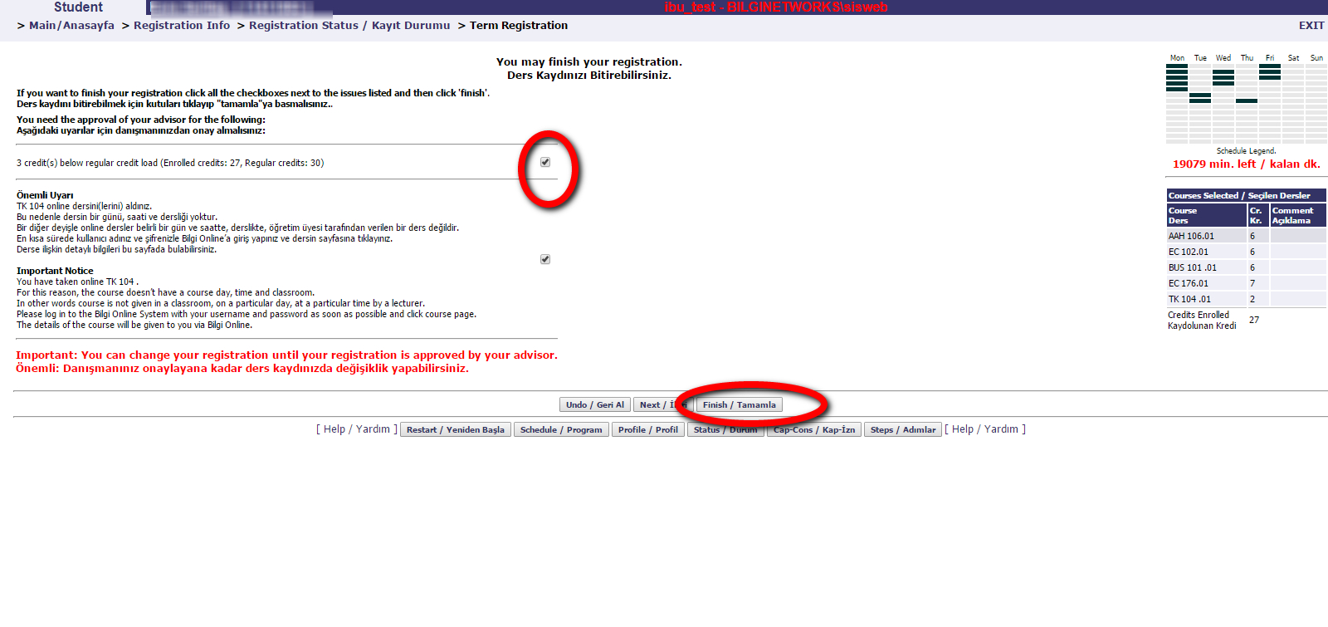
You can finish your registration.
Please read the information carefully.
Click on the Checkboxes.
Click Finish.
“
”

Slide 18
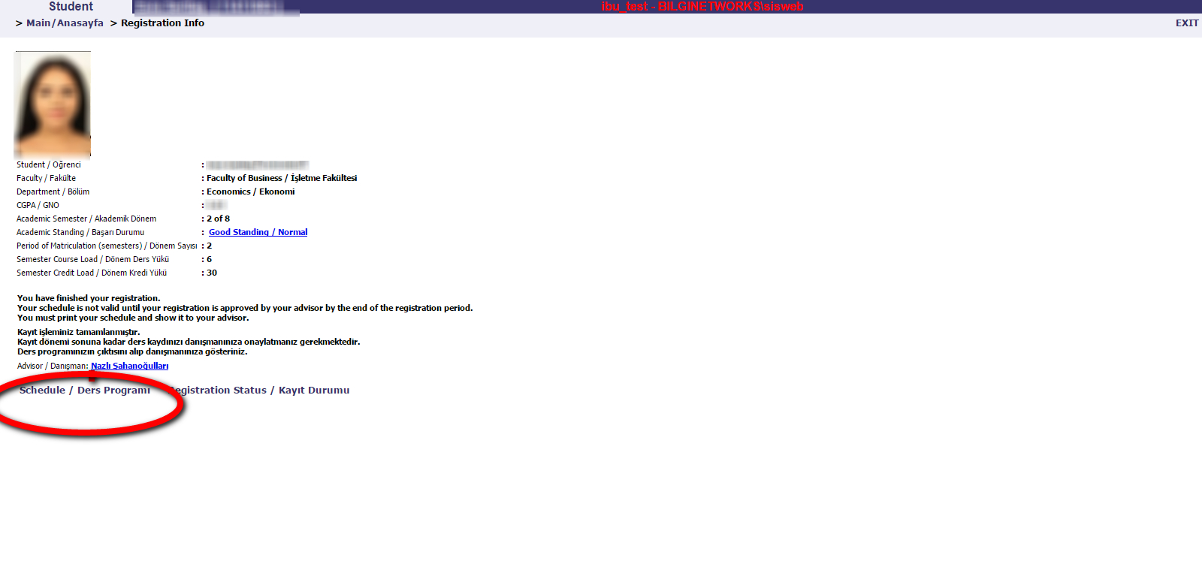
Your course registration will be submitted for your advisor’s approval. Please check your schedule under Schedule.
“
”

Slide 19
IF YOU CLICK FINISH BUTTON AND FINALIZE YOUR REGISTRATION, YOU CAN RETURN TO THE SYSTEM
TO CHANGE YOUR COURSES (PROVIDED THAT IT HAS NOT BEEN APPROVED BY THE ADVISOR YET).
STEPS FOR EDITING COURSES
Click on ‘Term Registration.’
Enter your registration code to restart your course registration.
When you complete your selection, click the finish button and get your registration code approved by your advisor.

Slide 20
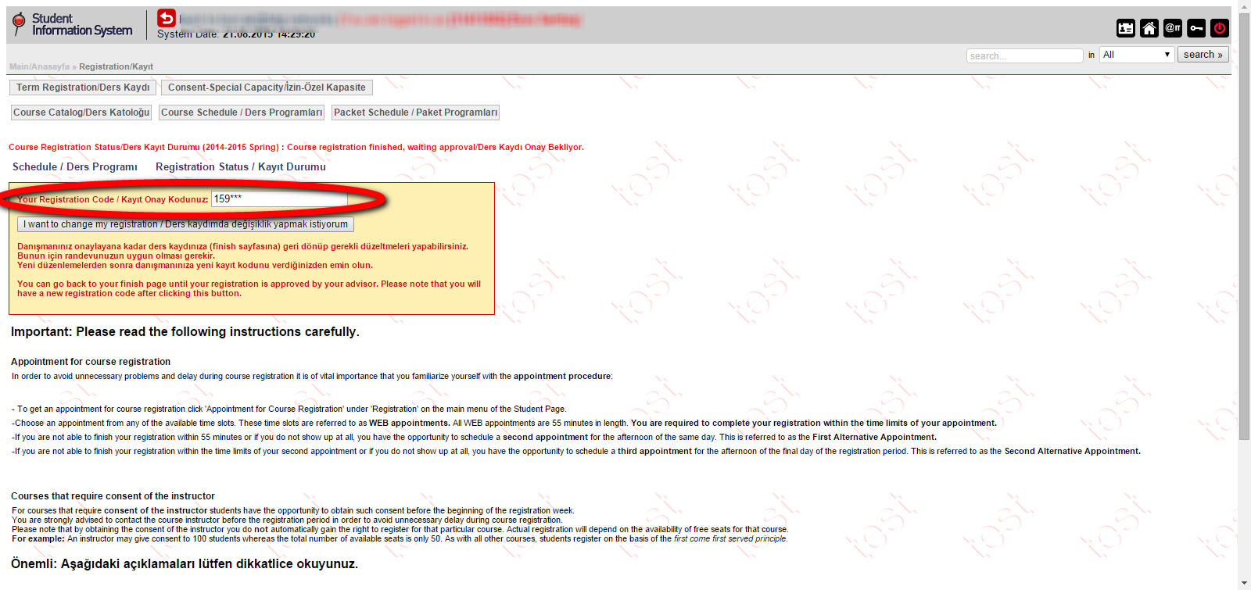
Click ‘Term Registration’ and enter your registration code
to restart your course registration.
“
”

Slide 21
ADD-DROP
You can change your elective courses only during the add-drop period from your personal student page (SIS) under the add-drop link between:
February 26-18, 2024.

Slide 22

WITHDRAWAL
You can withdraw from any of your elective courses from your personal student page (SIS) under the withdrawal request link 3 May 3 ,2024.

Slide 23
Graduate Student Affairs
santralistanbul Campus
L 1 Ground Floor – Z-16

Slide 24
WISHING YOU A SUCCESSFUL SEMESTER!

