Slide 1

Kişisel Verileri Koruma Sempozyumu
10 Aralık 2018, İstanbul
Leyla Keser
Direktör

Slide 2


Slide 3
A brief history of the General Data Protection Regulation (May 25, 2018)

Slide 4
Data Protection Laws∗ -1-
  (i) 129 countries now have data privacy laws (25 African countries) which at least meet the ten minimum standards set by international agreements as early as 1980;
  (ii) 60% of these laws are from outside Europe;
  (iii) 47 of the 129 laws have been enacted this decade, an average of 5 new laws per annum;
  (iv) At least 33 further countries have official Bills in the legislative process; and (v) Many countries (not only in the EU) are now enacting, or have already enacted, new laws to strengthen their original DP laws.
∗ Graham Greenleaf: Global Convergence of Data Privacy Standards and Laws: Speaking Notes for the European Commission Events on the Launch of the General Data Protection Regulation (GDPR) in Brussels & New Delhi, 25 May 2018, UNSW Law Research Paper No. 18-56, 8 Pages Posted: 12 Jun 2018 Last revised: 24 Aug 2018

Slide 5
Data Protection Laws -2-
Global convergence on higher standards is occurring, not chaotic development.
The GDPR is already influencing a higher level of legislative convergence. An incomplete study of over 30 countries outside Europe (in Africa, Asia and elsewhere), shows that six new ‘GDPR principles’ have been enacted by at least 10 countries, and all new GDPR principles by at least one.
‘GDPR creep’, voluntary convergence by businesses where there is no legal obligation, is a new global phenomenon.

Slide 6
Data Protection Laws -3-
There is convergence on a global treaty, (Global) Data Protection Convention 108, which originated with the Council of Europe, but is being acceded to by non-European countries since 2011.

Slide 7
GDPR Readiness of the EU
A report from IT Governance found that six months after the implementation of the EU General Data Protection Regulation,
  only 29 percent considered themselves compliant, TechRepublic reports.
  The report surveyed 210 firms across industries in the EU, finding that while nearly 60 percent were aware of data subject access requests, only 29 percent had plans to operationalize the change.
  The report also found that 61 percent of organizations said basic controls were in place to address data security and breach management, and more than 50 percent responded they had procedures in place for breach notification.
https://iapp.org/news/a/report-finds-29-percent-of-eu-organizations-considered-compliant-with-gdpr/

Slide 8
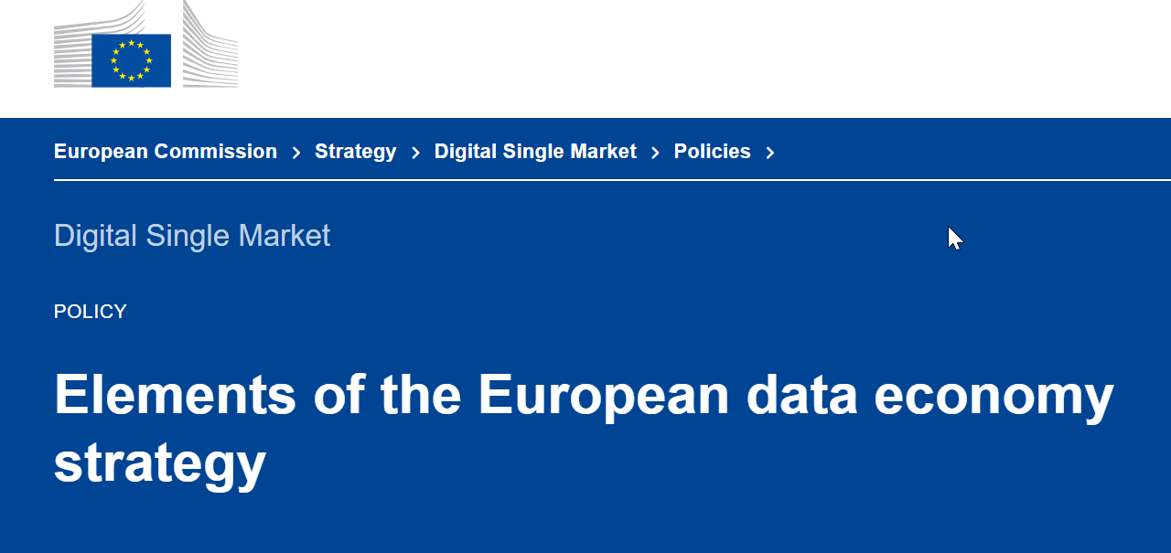
The data-driven economy stimulates research and innovation on data, and increases business opportunities and availability of knowledge and capital across Europe. The value of the EU data economy was more than €285 billion in 2015, representing over 1.94 % of the EU GDP.
If favourable policy and legislative conditions are put in place in time and investments in ICT are encouraged, the value of the European data economy may increase to €739 billion by 2020, representing 4 % of the overall EU GDP.
The European Commission adopted the Communication ‘Towards a common European data space’ on 25 April 2018.
A proposal for a review of the Directive on the re-use of public sector information (PSI Directive);
An update of the 2012 Recommendation on access to and preservation of scientific information; and
Guidance on sharing private sector data in B2B and B2G contexts.
All processing of data has to be done in full respect of the data protection rules (GDPR and ePrivacy legislation), which provide a solid framework for digital trust — a precondition for the sustainable development of the data economy

Slide 9

The new Brazilian General Data Protection Law
August 14, 2018, Brazil approved the General Data Protection Law. The law goes into effect 18 months after signing, giving companies until 2020 to bring their data processing practices into compliance.
The Law follows GDPR provisions.

Slide 10

Uganda’s New Data Protection Law
The Parliament of Uganda has on 6th Dec 2018 passed the data protection bill.

Slide 11

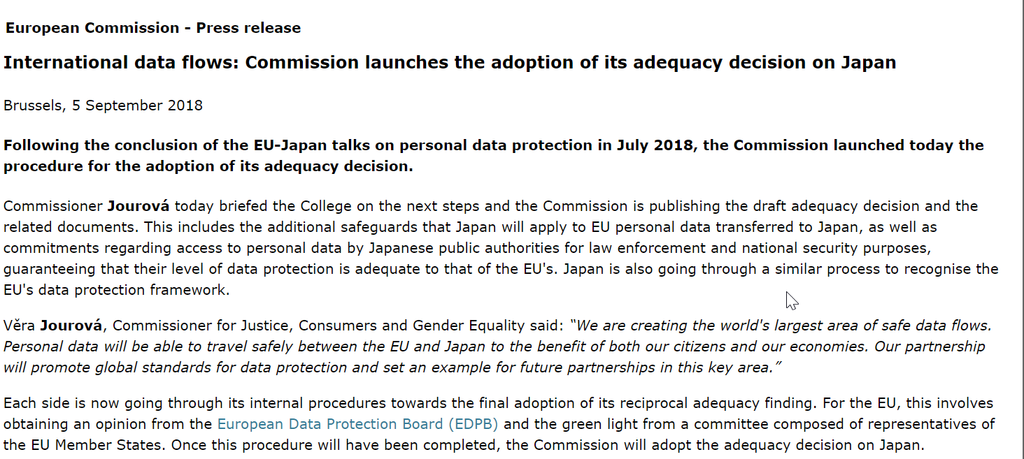
Japan’s Adequacy Decision Journey -1-

Slide 12
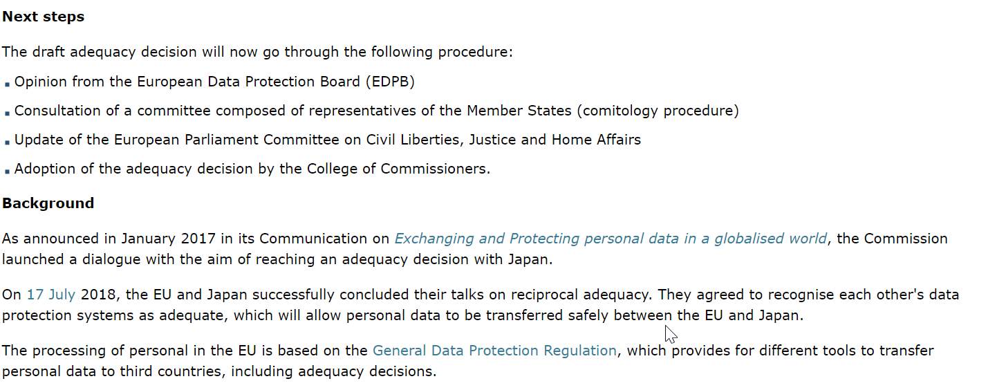
Japan’s Adequacy Decision Journey -2-

Slide 13
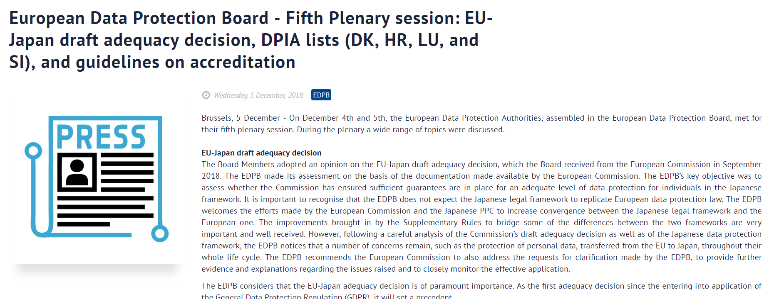
Japan’s Adequacy Decision Journey -3-

Slide 14
Japan: EU Adequacy Discounted
2018) 155 Privacy Laws & Business International Report 8-10
4 Pages Posted: 26 Nov 2018
Graham Greenleaf
University of New South Wales, Faculty of Law
Date Written: October 1, 2018

Slide 15

BREXIT
On Brexit-day∗:
UK no longer an EU state
UK becomes a third country
Transfer back applies to UK
Transfers must end
Huge commercial impact
∗ Lambert, Paul; Brexit and Data Protection, December 7, 2018, Presentation prepared for the IT Law Master Program of the Bilgi IT Law Institute.

Slide 16

US Sector Specific and State Level Data Protection&Privacy Laws&Standards
Fair Information Practices Act 1974
4th Amendment Searches&Seizures
The Video Privacy Protection Act (VPPA)
Cable Communications Policy Act of 1984
The CAN-SPAM Act, e-mail Marketing
The Computer Fraud and Abuse Act
COPPA-Children’s Privacy
The Driver’s Privacy Protection Act
The Electronic Communications Privacy Act
The Telecommunications Act
The Fair Credit Reporting Act
The Family Educational Rights and Privacy Act
The Right to Financial Privacy Ac
The Gramm-Leach-Bliley Act (GLBA)
HIPAA
OCGA, Genetic Testing
California Consumer Privacy Act
Massachussets Data Protection Law
NIST&PCI-DSS

Slide 17
More than 200 companies call for US privacy law
The Business Roundtable, a group of more than 200 retailers, tech companies and financial institutions, plans to release recommendations for a federal U.S. privacy law, The Washington Post reports. The Business Roundtable seeks for data-collection requirements to be universal across all industries and for the Federal Trade Commission to receive more enforcement authority and resources. The group also recommends a streamline of current federal data-collection laws to avoid any regulatory conflicts, a national data breach notification law, and considerations for the impact a federal privacy law would have on small businesses.
https://iapp.org/news/a/tech-companies-financial-institutions-pitch-recommendations-for-federal-u-s-privacy-law/

Slide 18
Big Data
Big data can be thought of as an asset that is difficult to exploit. AI can be seen as a key to unlocking the value of big data; and machine learning is one of the technical mechanisms that underpins and facilitates AI. The combination of all three concepts can be called ‘big data analytics’.

Slide 19
Some of the Distinctive Aspects of Big Data Analytics
  the use of algorithms
  the opacity of the processing
  the tendency to collect ‘all the data’
  the repurposing of data, and
  the use of new types of data.

Slide 20
How do Big Data Practices Conflict with the Current EU Data Protection Regime?
Unlike previous data processing models, affordances of Big Data for large-scale data aggregation from multiple and diverse sources, significantly expand the range of personally identifiable data.
Constant expansion of networks with computerised objects (wearable devices, home appliances, vehicles, cargo containers, etc.) in communication with each other –also referred to as IoT or smart ambience- will further complicate the distinction between personal and non-personal data.
This brings us closer to a point where “Personal data = All data”∗. Therefore, as the distinction between personal and non-personal data is getting blurred, it becomes questionable whether building a data protection regime around the concept of personal data was a credible approach?
∗ Nadezhda Purtova, The Law of Everything. Broad Concept of Personal Data and Future of EU Data Protection Law, 2018 Law, Innovation and Technology 10(1), Tilburg University - Tilburg Institute for Law, Technology, and Society (TILT), https://papers.ssrn.com/sol3/papers.cfm?abstract_id=3036355

Slide 21
Most of the personal data handled today is not manually collected but gathered and aggregated by and through machines.
The regulatory attempts regarding the online trackers –cookies, beacons, etc.- has so far proved the inefficiency of current “consent OR no-consent” regime. A consent regime which is in harmony with the algorithmic transparency framework requires a gradual, traceable and intelligible protocol of communication at the code level.

Slide 22
Prior to Big Data practices, principles of purpose limitation and data minimisation served as efficient legal safeguards against abusive data practices. Through these principles, the data protection regime intends to reduce the risk of harm in case of data misuse or data leaks.
Given the fact that Big Data involves deep and diverse analysis of data, predictive profiling and the relevant data-mining techniques are found not to be fully compatible with the EU data protection regime.
Purpose limitation and data minimisation are principles implementation of which are dependent on certain enacted and applied transparency requirements.
Notes:
According to the EU data protection regime, processing of personal data must be adequate, relevant and not excessive in relation to the specific purpose for which the data operations are carried out.

Slide 23
Data Protection Implications
Some types of big data analytics, such as profiling, can have intrusive effects on individuals.
Organisations need to consider whether the use of personal data in big data applications is within people’s reasonable expectations.
The complexity of the methods of big data analysis, such as machine learning, can make it difficult for organisations to be transparent about the processing of personal data.
Source: Big Data, Artificial Intelligence, Machine Learning and Data protection, https://ico.org.uk/media/for-organisations/documents/2013559/big-data-ai-ml-and-data-protection.pdf

Slide 24
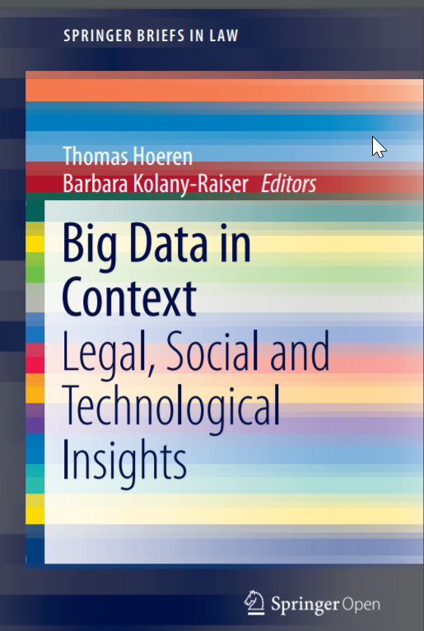
Big Data&Data Quality
Data quality is an issue of growing relevance. However, accuracy and veracity can only be safeguarded as long as effective mechanisms guarantee adequate quality standards for data.
There are no globally valid and recognized industry standards for data quality. We are still far from a harmonization and standardization.

Slide 25
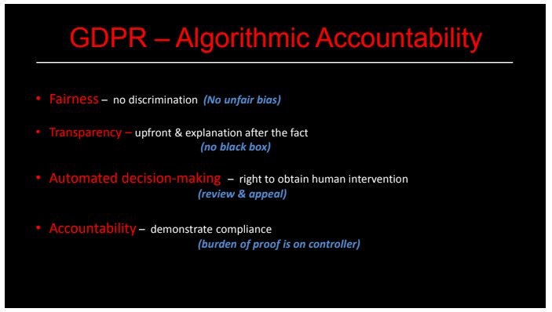
Algoritmic Accountability

Slide 26
Algorithmic Transparency/Accountability and TRUST
Attempts to implement a right to explanation that opens the “black box” to provide insight into the internal decision-making process of algorithms face four major legal and technical barriers.
  First, a legally binding right to explanation does not exist in the GDPR.
  Second, even if legally binding, the right would only apply in limited cases (when a negative decision was solely automated and had legal or other similar significant effects).
  Third, explaining the functionality of complex algorithmic decision-making systems and their rationale in specific cases is a technically challenging problem. Explanations may likewise offer little meaningful information to data subjects, raising questions about their value.
  Finally, data controllers have an interest in not sharing details of their algorithms to avoid disclosing trade secrets, violating the rights and freedoms of others (e.g. privacy), and allowing data subjects to game or manipulate the decision-making system.
  Building trust is essential to increase societal acceptance of algorithmic decision-making. To close current gaps in transparency and accountability that undermine trust between data controllers and data subjects, we propose to move beyond the limitations of the GDPR. We argue that counterfactuals should be used as a means to provide explanations for individual decisions.
Sandra Wachter/Brent Mittelstadt/Chris Russell; COUNTERFACTUAL EXPLANATIONS WITHOUT OPENING THE BLACK BOX: AUTOMATED DECISIONS AND THE GDPR, Harvard Journal of Law & Technology Volume 31, Number 2 Spring 2018

Slide 27
AI and Ethics
Governments of large countries have significant influences over the development of the world. Therefore, the lack of consistency and consensus in concepts, values and systems as well as the lack of mutual trust and cooperation between governments would likely endanger humanity in the Artificial Intelligence era.
At the moment, all governments are only beginning to address the issues related to AI through national strategies, laws and regulations. This part summarizes the key policies and goals of strategies, as well as related policies and initiatives that have been announced of G7 (The United States, France, The United Kingdom, Canada, Italy, Germany, Japan), European Union, and major governments in the field of AI (Russia, China, India).
Criteria for evaluation and control of ethics in AI
  Purpose: The purpose of AI is to achieve well-being and happiness of the people, to unleash the limitless possibility of humans, to provide more freedom to people
  Data sets: how to collect, where, whom, for what, by what. Data sets using for AI require accuracy, validation and transparency.
  Algorithm: transparency, fairness, non-bias
  Transparency in national resources
  Refrains from investing in harmful uses of AI
  Responsibility for mistakes: It must be clear where liability lies when systems make mistakes. General principles should guide accountability. • Transparency in decision making: It must be clear when AI systems need to explain their actions to humans to show why a decision was made, and when, if ever, such transparency is not necessary
  Avoiding bias - Steps must be made to stop systemic bias. Core values such as equality, diversity and lack of discrimination must be promoted. • Core ethical values - What are the core ethical values of AI to be? • Data protection and Intellectual Property - The importance of data protection, IP ownership and cyber security must be recognized and balanced against the need to use data to promote innovation. • Mitigating social dislocation - The codes should confront what obligations rest on actors who deploy AI to mitigate the social dislocation that results. • Cybersecurity - The need for strong protection against hacking will increase as AI systems take a heightened role in society.
AIWS REPORT ABOUT AI ETHICS; Michael Dukakis, Nguyen Anh Tuan, Thomas Patterson, Thomas Creely, Nazli Choucri, Paul Nemitz, Derek Reveron, Hiroshi Ishiguro, Eliot Weinman, Kazuo Yano, Boston, December 3, 2018, https://dukakis.bostonglobalforum.org/wp-content/uploads/sites/15/AIWS-Report-official-version-December-3.pdf

Slide 28
Declaration Of Cooperation On Artificial Intelligence
In April 2018, the EU Member States signed a Declaration of cooperation on Artificial Intelligence in which they agreed to work together on the most important issues raised by AI, from ensuring Europe’s competitiveness in the research and deployment of AI, to dealing with social, economic, ethical and legal questions.
Ensuring an appropriate ethical and legal framework, based on the Union’s values and in line with the Charter of Fundamental Rights of the EU. This includes forthcoming guidance on existing product liability rules, a detailed analysis of emerging challenges, and cooperation with stakeholders through a European AI Alliance to develop AI ethics guidelines.
Notes:
For a critical view on guidelines of the Council of Europe’s new privacy guidelines see Alessandro Mantelero, ‘Regulating Big Data. The Guidelines of the Council of Europe in the Context of the European Data Protection Framework’ (2017) 33 Computer Law & Security Review 584.

Slide 29

The European AI Alliance: High-Level Expert Group
High-Level Expert Group on AI (AI HLEG), which consists of 52 experts who have been selected by the Commission will draft AI ethics guidelines, which will offer guidance on how to implement ethical principles when developing and deploying AI, building on the work of the European Group on Ethics in Science and New Technologies and the European Union Agency for Fundamental Rights.
Regulatory foresight’ and ‘ethics foresight analysis’ at the same level of ‘technological foresight’, are needed to keep up with emerging implications of AI. This, however, cannot happen without a strong commitment to the following issues: clear ethical frameworks and guidelines, including the right to choose between being cared for by a human or a robot, and the right to refuse being profiled, tracked, or measured, and responsible AI design, which is necessary to build trust in the applications.
Notes:
EU v. US üzerine bilgi notu
We should also not ignore the fact that the discussion on “ownership” of data is to a great extent limited to Europe. This should be a reason for scepticism: is it really wise for Europe to take regulatory “leadership” in that respect? Why is legal protection not a concern of our main rival, the United States? Is it possible that Europeans are afraid of US power in the digital economy? The majority of the dominating drivers of the digital economy are indeed US companies (the Googles, Facebooks, WhatsApps, Amazons, and many others). And it is certainly true that those companies would not be as successful as they are if they did not have access to “big data”, or, more precisely, to our data ...
But is, then, “ownership” of our data the right answer to the challenge the European digital economy is facing vis-à-vis the US digital economy? It might be premature to provide conclusive answers to such questions today. And this short overview does not allow us to go into detail. But we can at least hint at some considerations.

Slide 30
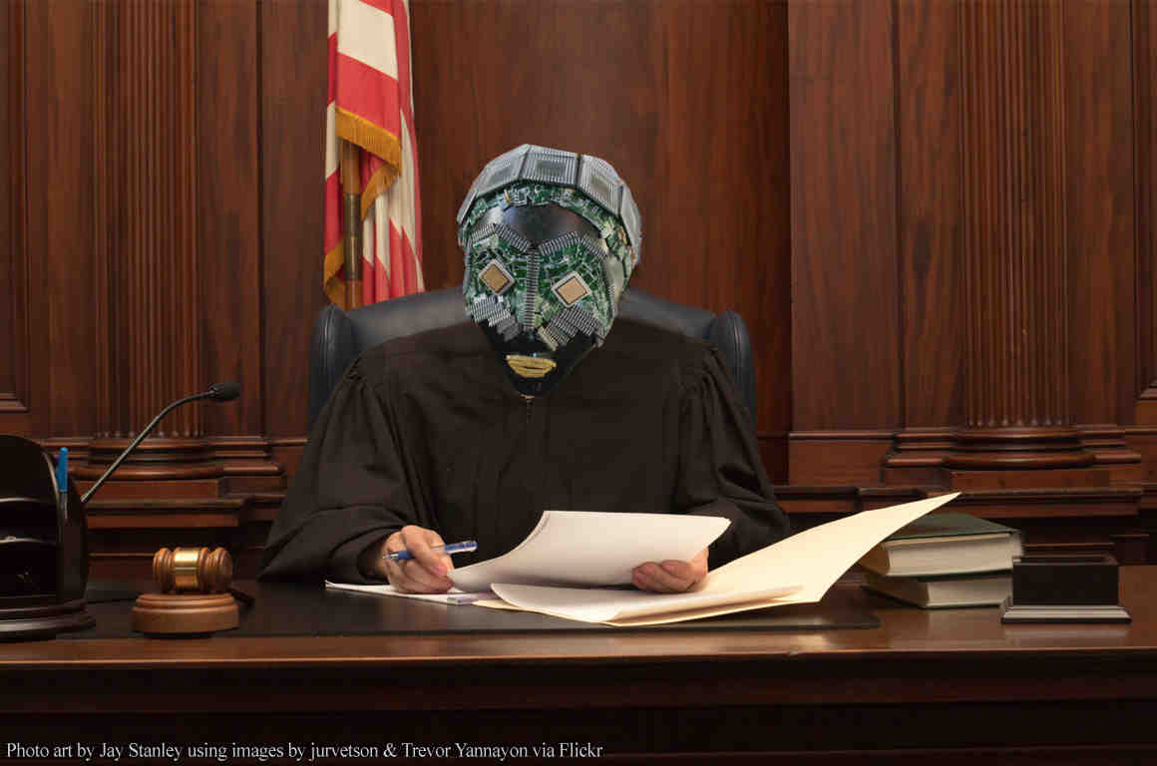
Algoritmic Judge

Slide 31
It’s not enough for AI to be “ethical”; it must also be “rights respecting”
AI-assisted decision making in the realms of criminal justice, hiring, lending, and more have been criticized for embedding and perpetuating patterns of human bias and discrimination. This is most obvious in the criminal justice system. Several years ago, ProPublica found that a ubiquitous risk assessment tool, COMPAS, treated African Americans differently than others: the algorithm misclassified them as having a “high risk of reoffending” at twice the rate of white Americans.
Hannah Hilligoss, Filippo A. Raso and Vivek Krishnamurthy, Artificial Intelligence & Human Rights: Opportunities & Risks; Berkman Klein Center Research Publication No. 2018-6, Posted: 25 Oct 2018, https://papers.ssrn.com/sol3/papers.cfm?abstract_id=3259344

Slide 32
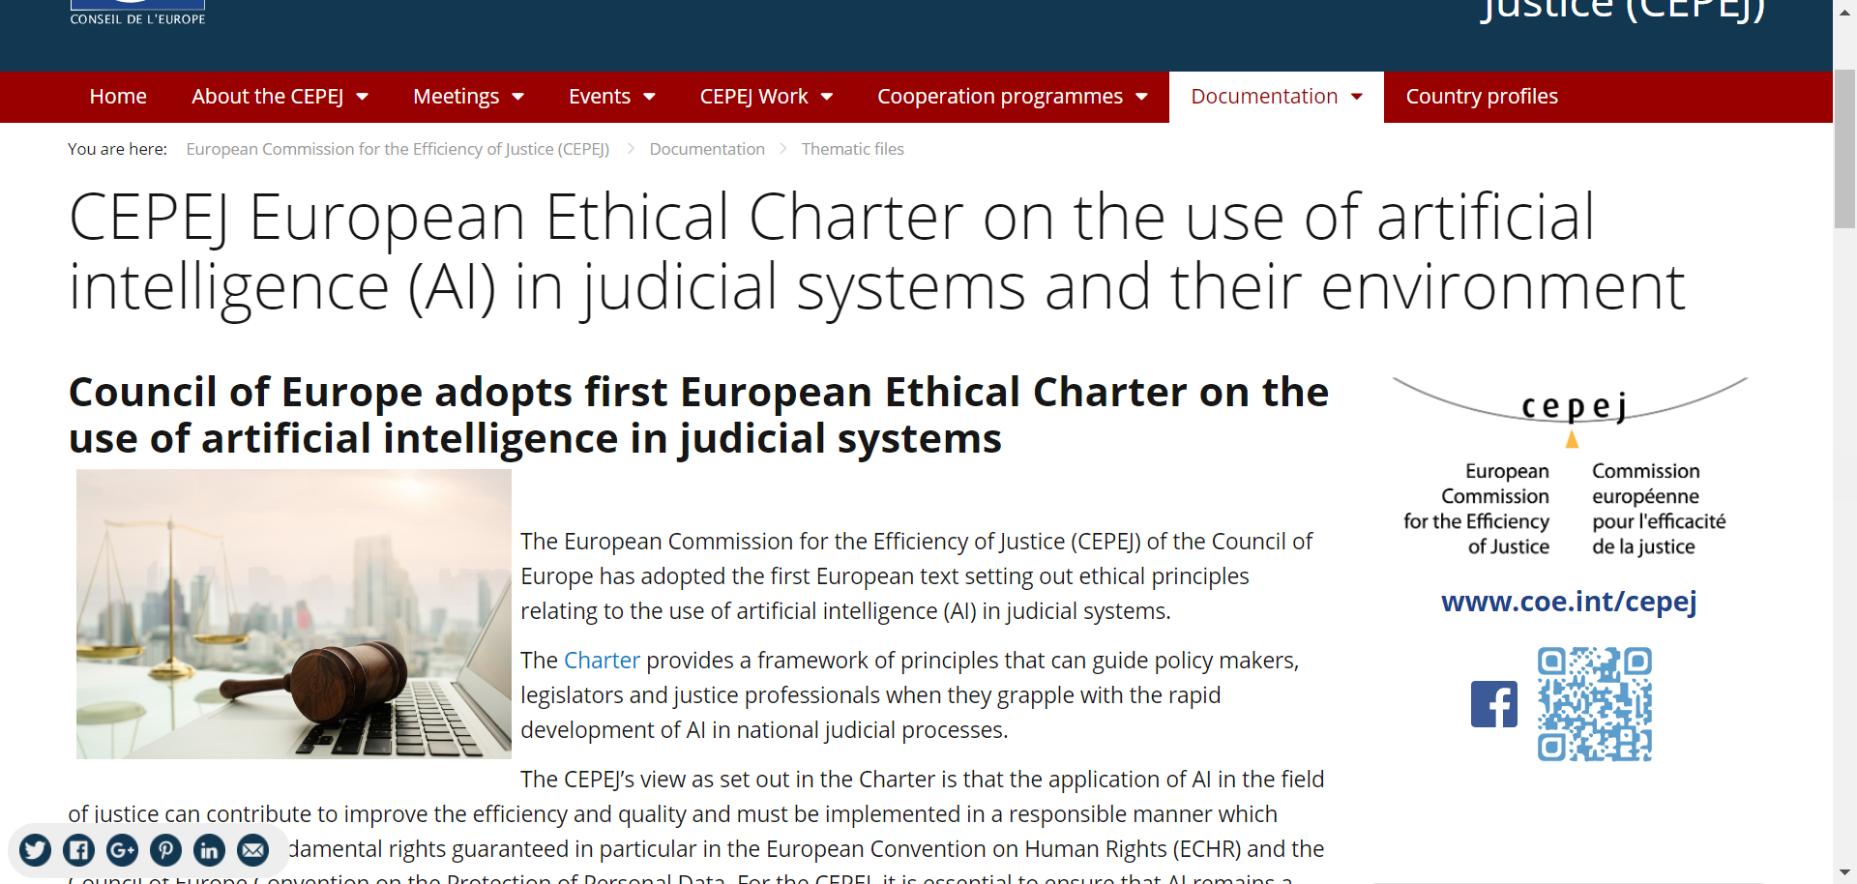

Slide 33
The CEPEJ’s view as set out in the Charter is that the application of AI in the field of justice can contribute to improve the efficiency and quality and must be implemented in a responsible manner which complies with the fundamental rights guaranteed in particular in the European Convention on Human Rights (ECHR) and the Council of Europe Convention on the Protection of Personal Data.
For the CEPEJ, it is essential to ensure that AI remains a tool in the service of the general interest and that its use respects individual rights.

Slide 34
The CEPEJ has identified the following core principles to be respected in the field of AI and justice:
Principle of respect of fundamental rights: ensuring that the design and implementation of artificial intelligence tools and services are compatible with fundamental rights;
Principle of non-discrimination: specifically preventing the development or intensification of any discrimination between individuals or groups of individuals;
Principle of quality and security: with regard to the processing of judicial decisions and data, using certified sources and intangible data with models conceived in a multi-disciplinary manner, in a secure technological environment;
Principle of transparency, impartiality and fairness: making data processing methods accessible and understandable, authorising external audits;
Principle “under user control”: precluding a prescriptive approach and ensuring that users are informed actors and in control of their choices.

Slide 35
Ethical guidelines: Japan Society for AI (2017)
Contribution to humanity
Abidance of laws and regulations
Respect for the privacy of others
Fairness
Security
Act with integrity
Accountability and social responsibility
Communication with society and self-development
Abidance of ethics guidelines by AI: AI must abide by the policies described above in the same manner as the members of JSAI, in order to become a member of a quasi-member of society.
Source: https://www.ai-gakkai.or.jp/en/

Slide 36
Autonomous Vehicles
CYBER-SECURITY AND DATA PROTECTION
The international regulatory agenda is starting to include new aspects of road safety related to AV: Cyber-security and data protection. For example, the Ministers of Transport of the G7 are shifting their attention to these issues. In their Declaration on Automated and Connected Driving in 2015, Ministers called for cooperation on ensuring data protection and cyber-security, in addition to the coordination and adaptation of the regulatory framework and technical regulations that UNECE is already undertaking. This vision was reinforced in their meeting in Japan, in 2016 and again at Toronto, in 2017.
UNECE also realized that digitalization of transport is demanding new safety requirements to vehicles and infrastructure, protection for rights and liberties. In November 2017, UNECE identified 86 threats to security, and it is now discussing how to prevent or mitigate them. In December 2017, it created the Task Force for Cyber-Security and Over-The-Air issues (TF-CS/OTA), which is working on two recommendations (cyber-security and data protection, and software updates) that are expected by March 2018.
In March 2017, UNECE already released guidelines on cyber-security and data protection for construction of AV. These guidelines define the three elements of cyber-security as confidentiality, integrity, and authenticity of the information; and establishes the principles of data protection by default and data protection by design. Future UN regulations will have to follow these guidelines.
EU efforts also resonate with UNECE’s, reinforcing the cyber-security and privacy regulatory frameworks. In cyber-security, the EU is working on the so called “Cyber-security package” to complement the Directive on Security of Network and Information Systems (NIS) of 2016. In the Cyber-Security Package, the EU will establish an European certification framework for ICT security products, as a one-stop-shop for cyber-security certification, which will rely mostly on international standards, such as the UNECE guidelines on cyber-security.
With regards to privacy, the EU is working on the new ePrivacy Regulation that will complement the General Data Protection Regulation (GDPR). The ePrivacy Regulation will replace the ePrivacy Directive and will add stronger protection to content and metadata of communications, which can occur among automated vehicles or vehicles and infrastructure.
“Autonomous Vehicles: 3 International Regulatory Discussions To Be Aware Of” ©2018. Published in The SciTech Lawyer, Vol. 14, №4, Summer 2018, by the American Bar Association.

Slide 37
Understanding Media and Information Quality in an Age of Artificial Intelligence, Automation, Algorithms and Machine Learning
Democracy is under stress that would have been unimaginable a decade or two ago. The victory of Donald Trump in the U.S. presidential campaign and the successful “Leave” campaign in the UK Brexit referendum led the Oxford English Dictionary to select “post-truth” as word of the year for 2016.
Social media, bots, hyper-targeted behavioral marketing — all have been seen as culprits or at least catalysts in public conversations. Technology has altered the foundations of news and media, and as trust in media continues to decline, artificial intelligence, machine learning, and algorithms have come to play a critical role not only as threats to the integrity and quality of media, but also as a source of potential solutions.
Yochai Benkler, Robert Faris, Hal Roberts, Nikki Bourassa: https://medium.com/berkman-klein-center/understanding-media-and-information-quality-in-an-age-of-artificial-intelligence-automation-a562620c7039

Slide 38
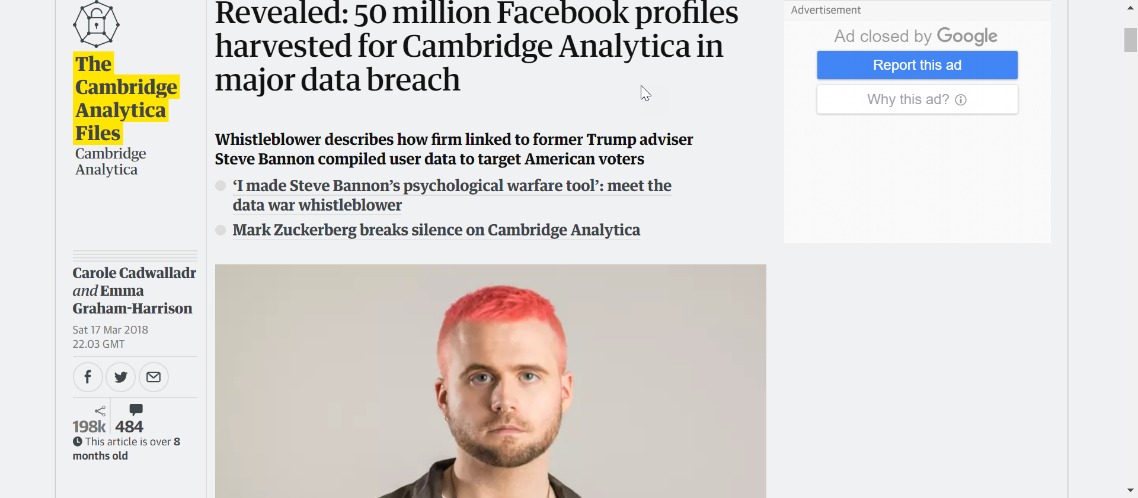

Slide 39
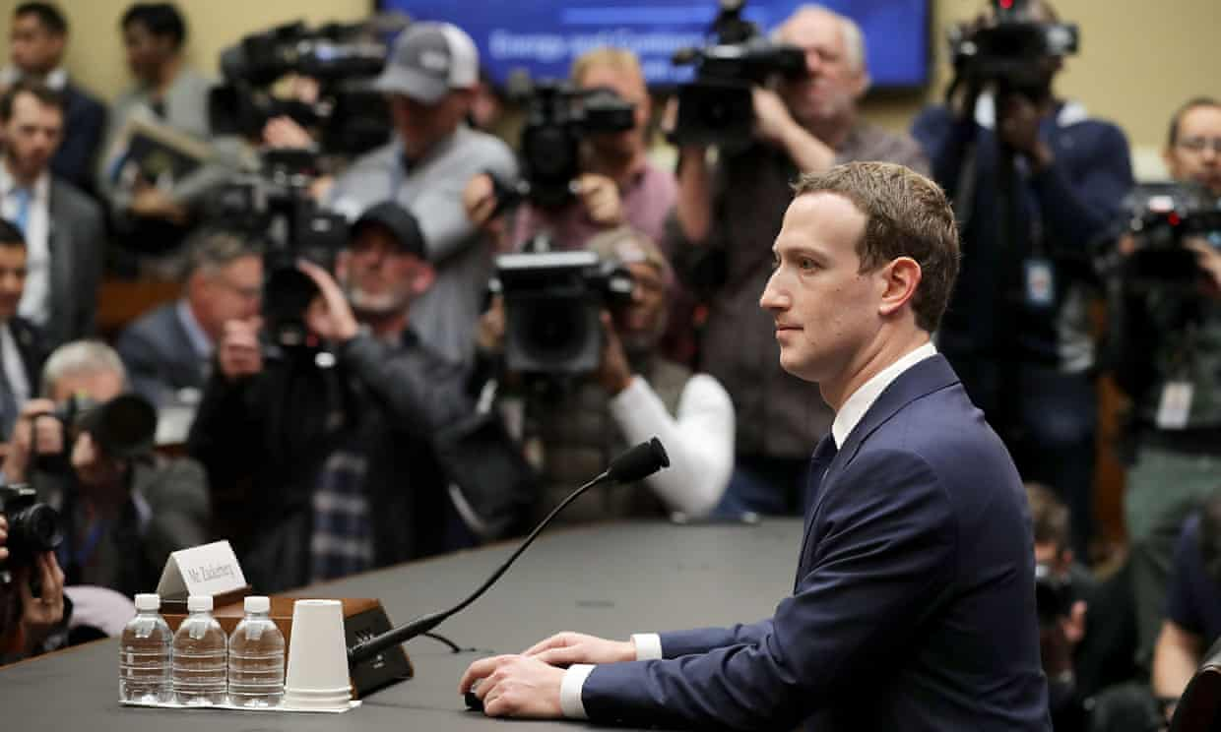
Facebook fined for data breaches in Cambridge Analytica scandal
Firm fined £500,000 for lack of transparency and failing to protect users’ information
Photograph: Chip Somodevilla/Getty Images: https://www.theguardian.com/technology/2018/jul/11/facebook-fined-for-data-breaches-in-cambridge-analytica-scandal

Slide 40
Italian regulator fines Facebook £8.9m for misleading users
Company criticised over data misuse and ordered to issue an apology on its website and app
The two fines issued by Italy’s competition watchdog are some of the largest levied against the social media company for data misuse, dwarfing the £500,000 fine levied by the British Information Commissioner’s Office in September – the maximum that body was able to issue.
The Italian regulator found that Facebook had breached articles 21, 22, 24 and 25 of the country’s consumer code by:
Misleading users in the sign-up process about the extent to which the data they provide would be used for commercial purposes.
Emphasising only the free nature of the service, without informing users of the “profitable ends that underlie the provision of the social network”, and so encouraging them to make a decision of a commercial nature that they would not have taken if they were in full possession of the facts.
Forcing an “aggressive practice” on registered users by transmitting their data from Facebook to third parties, and vice versa, for commercial purposes.
The company was specifically criticised for the default setting of the Facebook Platform services, which in the words of the regulator, “prepares the transmission of user data to individual websites/apps without express consent” from users.
https://amp.theguardian.com/technology/2018/dec/07/italian-regulator-fines-facebook-89m-for-misleading-users?__twitter_impression=true

Slide 41
New Documents Show That Facebook Has Never Deserved Your Trust
A member of the United Kingdom’s Parliament published a trove of internal documents from Facebook, obtained as part of a lawsuit by a firm called Six4Three. The emails, memos, and slides shed new light on Facebook’s private behavior before, during, and after the events leading to the Cambridge Analytica scandal.
https://www.parliament.uk/documents/commons-committees/culture-media-and-sport/Note-by-Chair-and-selected-documents-ordered-from-Six4Three.pdf

Slide 42
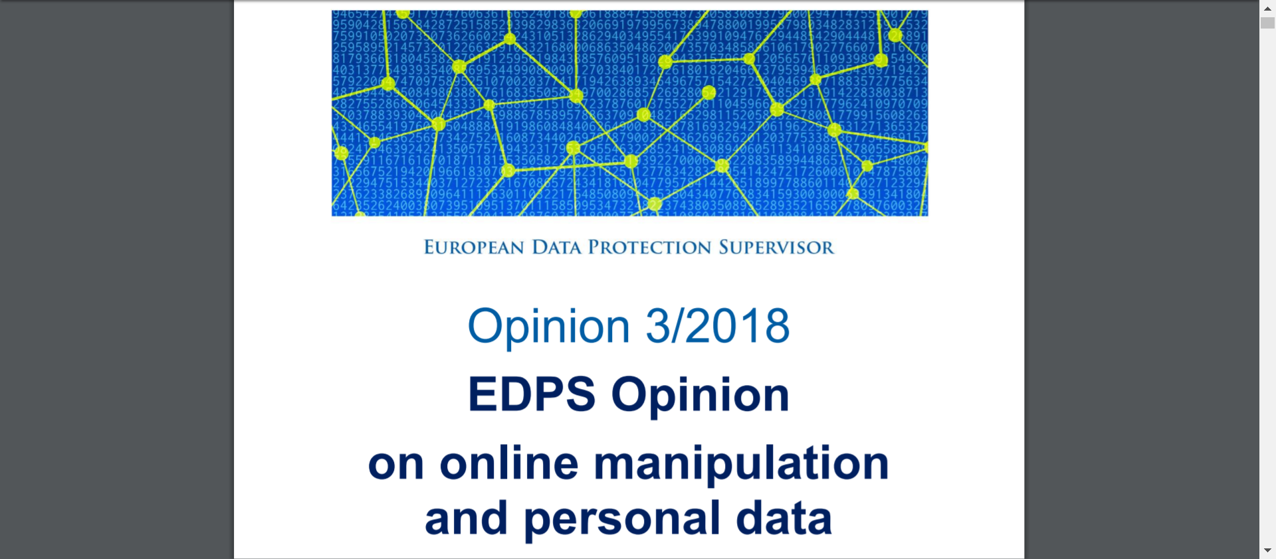

Slide 43
Big data analytics and artificial intelligence systems have made it possible to gather, combine, analyze and indefinitely store massive volumes of data. Over the past two decades, a dominant business model for most web-based services has emerged which relies on tracking people online and gathering data on their character, health, relationships and thoughts and opinions with a view to generating digital advertising revenue.

Slide 44
The ensuing debate has revolved around the misleading, false or scurrilous information (‘content’) served to people with the intention of influencing political discourse and elections, a phenomenon come to be labelled ‘fake news’ or ‘online disinformation’.
Solutions have focused on transparency measures, exposing the source of information while neglecting the accountability of players in the ecosystem who profit from harmful behaviour. Meanwhile market concentration and the rise of platform dominance present a new threat to media pluralism.
For the EDPS, this crisis of confidence in the digital ecosystem illustrates the mutual dependency of privacy and freedom of expression. The diminution of intimate space available to people, as a result of unavoidable surveillance by companies and governments, has a chilling effect on people’s ability and willingness to express themselves and form relationships freely, including in the civic sphere so essential to the health of democracy.
This Opinion is therefore concerned with the way personal information is used in order to micro-target individuals and groups with specific content, the fundamental rights and values at stake, and relevant laws for mitigating the threats.

Slide 45
The Future of Technology Law: Three Levels of Impact Assessment and Democracy, Rule of Law and Human Rights by Design in AI∗
What would be necessary to strengthen trust in technology in the age of Artificial Intelligence, in which high technology increasingly colonizes every aspect of life, is obligatory impact assessments for new technologies on three levels:
  First, the parliamentary technology impact assessment, on the level of policy making and legislation, in order to ascertain whether essential interests are touched on by the technology in question and thus what legislation to put in place to guarantee the public interest in that context.
  Second, on the level of the developers and users of such technology. For AI, it would certainly be warranted to extend by law the obligation of an impact assessment, which already exists when AI is processing personal data in the context of automated decision making,³¹ to all aspects of democracy, rule of law and fundamental rights, at least when AI has the potential to be used in the context of the exercise of public power, the democratic and political sphere or in the provision of services of general use, independent of whether personal data are processed or not.
  Third, individuals concerned by the use of AI should have a right, to be introduced by law, to an explanation of how the AI functions, what logic it follows, and how its use affects the interests of the individual concerned, thus the individual impacts of the use of AI on a person, even if the AI does not process personal data, in which case there is already a right to such information under GDPR.
  A new intensity of three-level impact assessment of technology is a necessary component of a new intensity of the dialogue between technology and democracy which is vital at a time when we are entering a world in which technologies like AI become all-pervasive and are actually incorporating and executing the rules according to which we live in large part.
∗ Paul Nemitz, Constitutional democracy and technology in the age of artificial intelligence Paul Nemitz, Published:15 October 2018, https://doi.org/10.1098/rsta.2018.0089

Slide 46
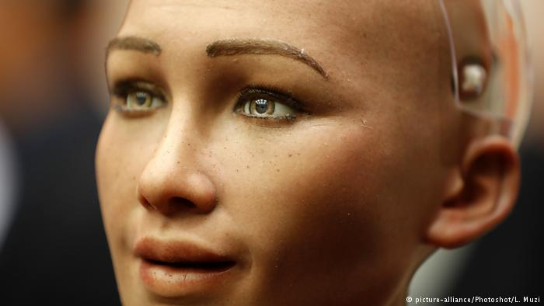
Saudi Arabia grants citizenship to robot Sophia

Slide 47

Inside Japan’s first robot-staffed hotel

Slide 48
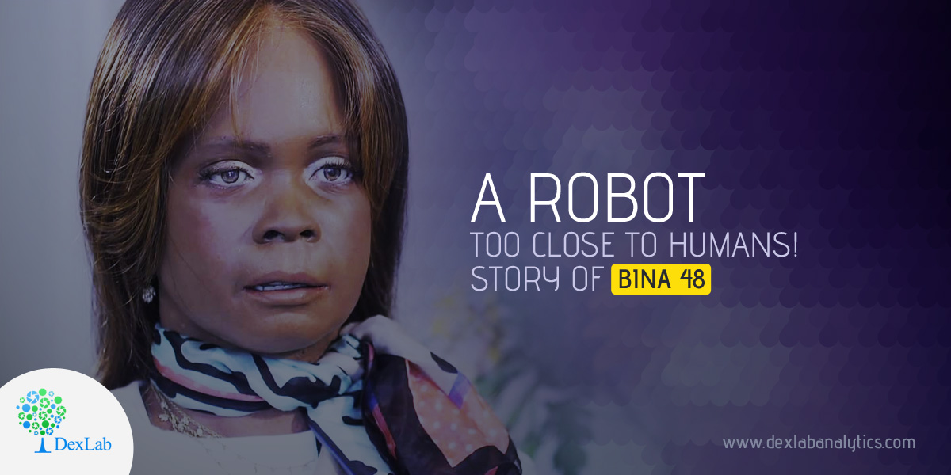
Meet the roboprofessor
The robot, Bina48, taught a philosophy course at West Point Military academy
The life-like bot taught two sessions of the course in front of about 100 students
William Barry, who has been using Bina48 to teach for several years, ultimately decided not to bring the robot back to the class after she couldn't keep up
Bina48 reached another milestone by completing a college philosophy course

Slide 49

Ray Kurzweil on what the future holds next
Join head of TED Chris Anderson for a very special conversation with legendary inventor and computer scientist Ray Kurzweil, recorded live onstage at TED2018. Listen in to hear what the man who makes a living from predicting the future arc of technology thinks is coming our way next -- including a specific prediction of when he thinks technology will finally gain human levels of language understanding.
https://www.ted.com/talks/the_ted_interview_ray_kurzweil_on_what_the_future_holds_next

Slide 50

Emre Bayamlıoğlu:
Intelligent Agents and Legal Personality” (Ajan Yazılımların Hukuki Statüsü) International Law and Trade Conference, (ILTC) http://iltc.eu/ 10-12 May 2007 İstanbul. Member of Organising Committee
Akıllı Yazılım Ve Hukuki Statüsü, Yapay Zeka ve Kişilik Üzerine Bir Deneme, http://bthukuku.blogspot.com/2008/06/akilli-yazilim-ve-hukuki-stats-dr-emre.html

Slide 51
European Parliament REPORT
27 January 2017
with recommendations to the Commission on Civil Law Rules on Robotics
(2015/2103(INL))
Committee on Legal Affairs
http://www.europarl.europa.eu/sides/getDoc.do?pubRef=-//EP//TEXT+REPORT+A8-2017-0005+0+DOC+XML+V0//EN

Slide 52
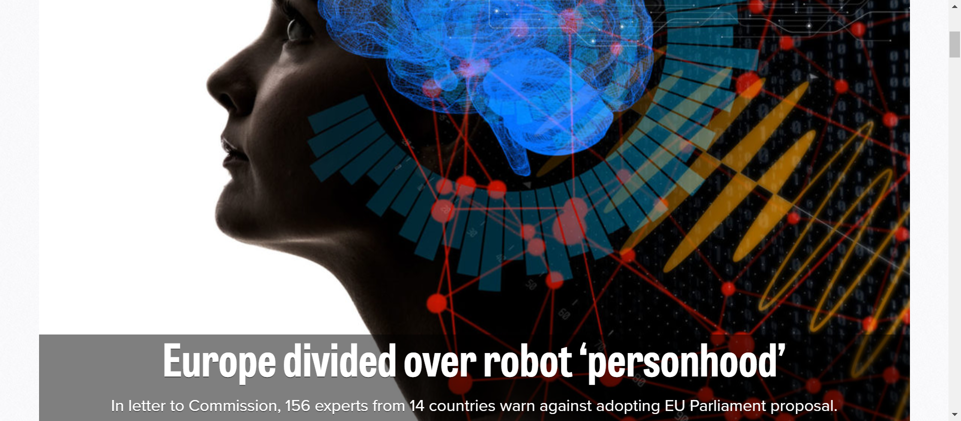

Slide 53
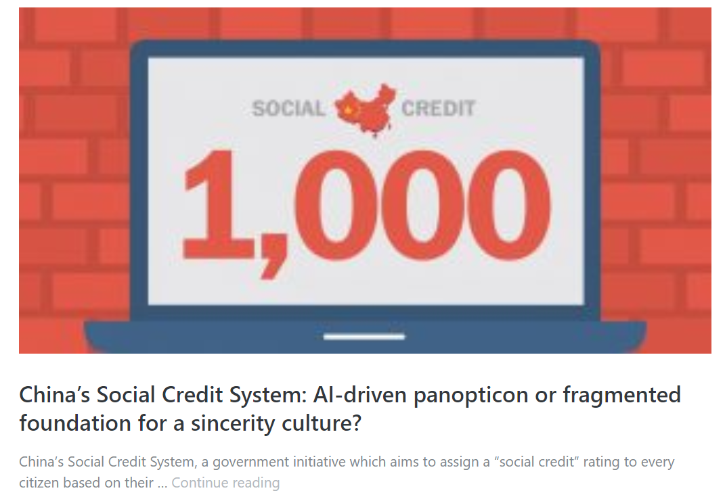

Slide 54
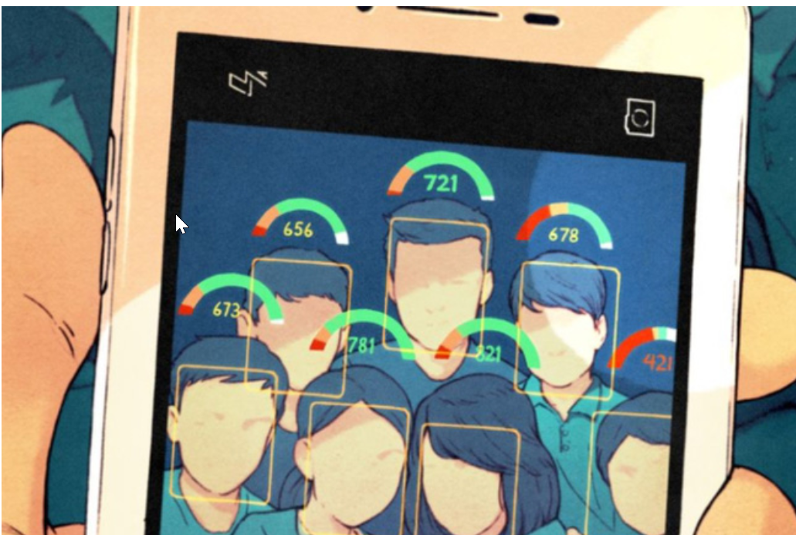
Social Credit System in China: Orwellian Future or Economic Knowhow?

Slide 55
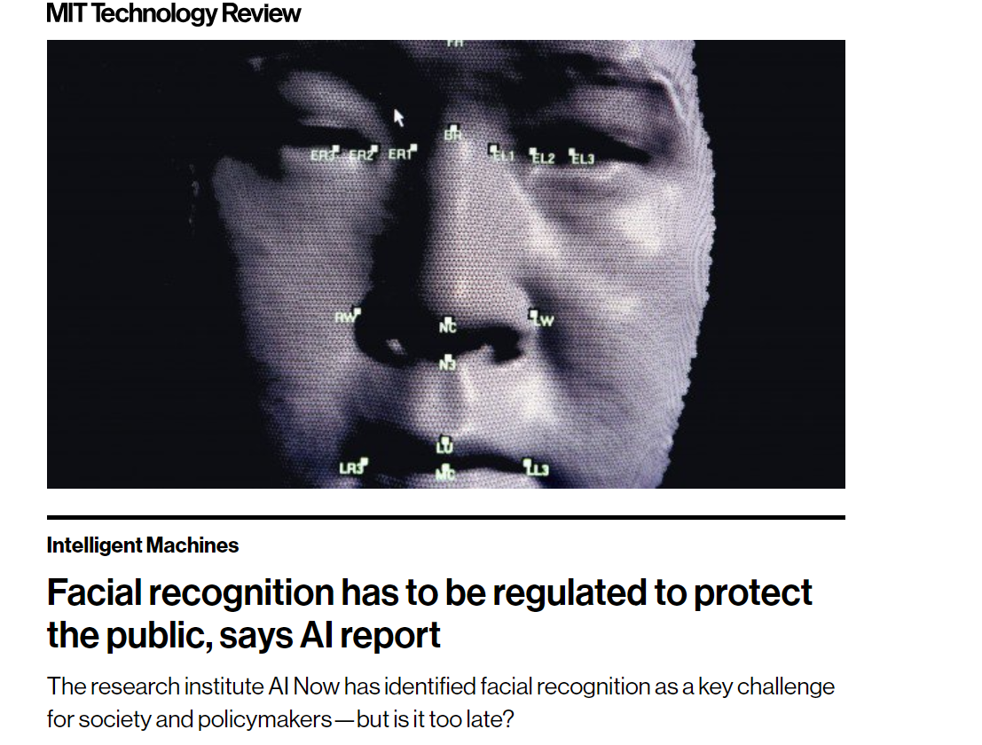

Slide 56
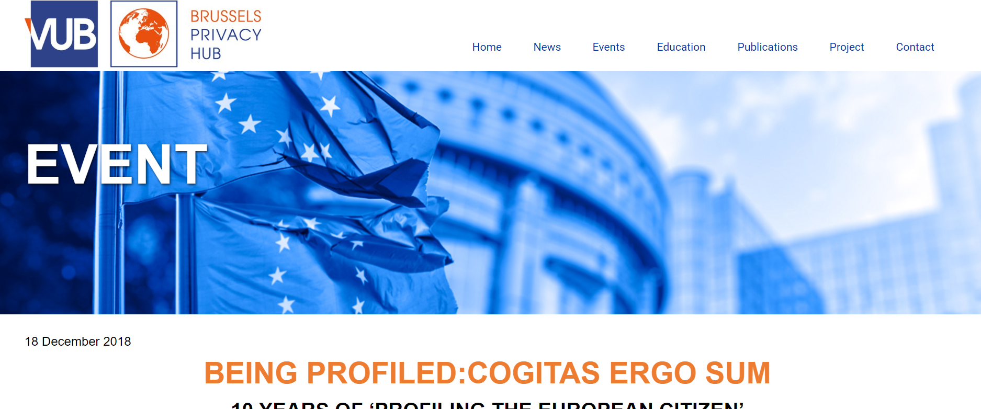

Slide 57
Important Data Breaches in 2018

Slide 58

Yahoo
3 million users impacted
Date disclosed: A separate data breach, occurring earlier around August 2013, was reported in December 2016. Initially believed to have affected over 1 billion user accounts, Yahoo! later affirmed in October 2017 that all 3 billion of its user accounts were impacted.
The recent breaches rank as some of the largest in U.S. history, trailing the 2017 Yahoo Inc. data breach that impacted 3 billion users and was subject to congressional hearings. Former Yahoo CEO Marissa Mayer left the company following the revelations.

Slide 59

Saks, Lord & Taylor
5 million records breached
Date disclosed: April 3, 2018

Slide 60

Pumpup
6 million records breached
Date disclosed: May 31, 2018

Slide 61

Sacramento Bee
19.5 million records breached
Date disclosed: June 7, 2018

Slide 62

Ticketfly
27 million records breached
Date disclosed: June 7, 2018

Slide 63

Panera
37 million records breached
Date disclosed: April 2, 2018

Slide 64

Facebook
At least 87 million records breached (though likely many more)
Date disclosed: March 17, 2018

Slide 65

MyHeritage
92 million records breached
Date disclosed: June 4, 2018

Slide 66
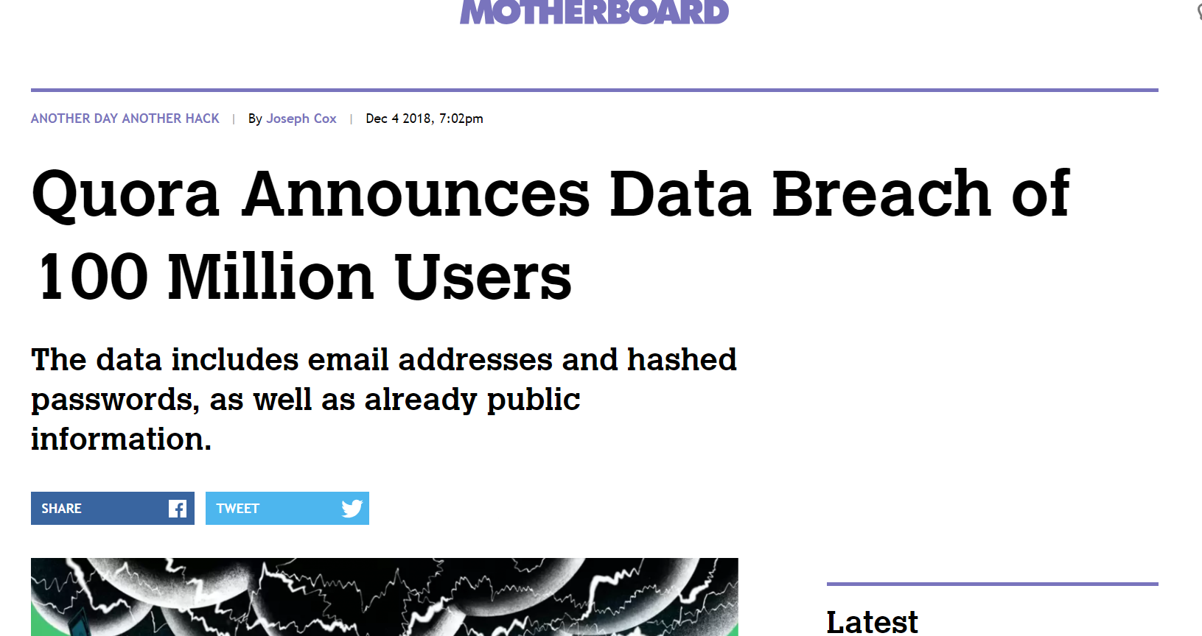
Quora
100 million account breached
Date disclosed: 4 December, 2018

Slide 67

Under Armour
150 million records breached
Date disclosed: May 25, 2018

Slide 68

Exactis
340 million records breached
Date disclosed: June 26, 2018

Slide 69

Aadhaar
1.1 billion records breached
Date disclosed: January 3, 2018

Slide 70

Cathay Pacific
9.4. million affected
Date disclosed: October 25, 2018

Slide 71

Marriott
500 million affected
Date disclosed: 30 November, 2018

Slide 72
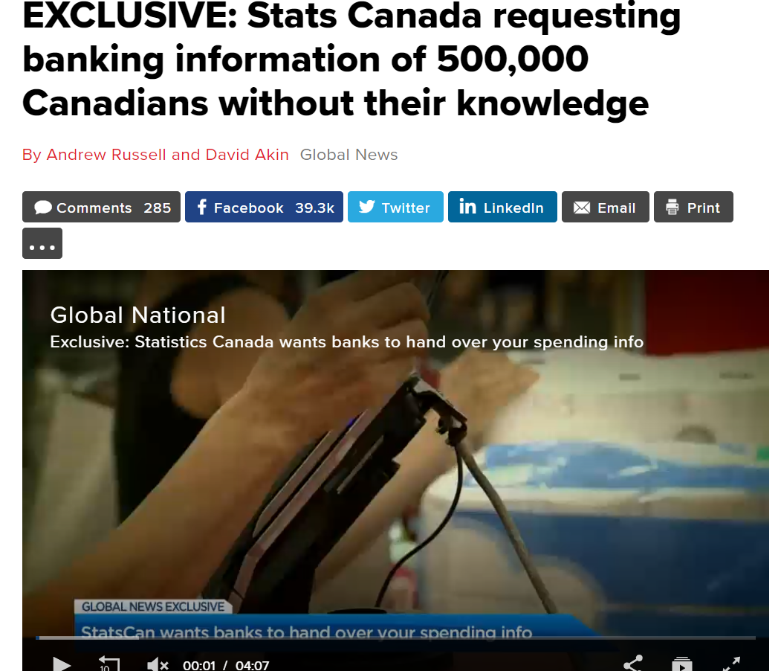

Slide 73
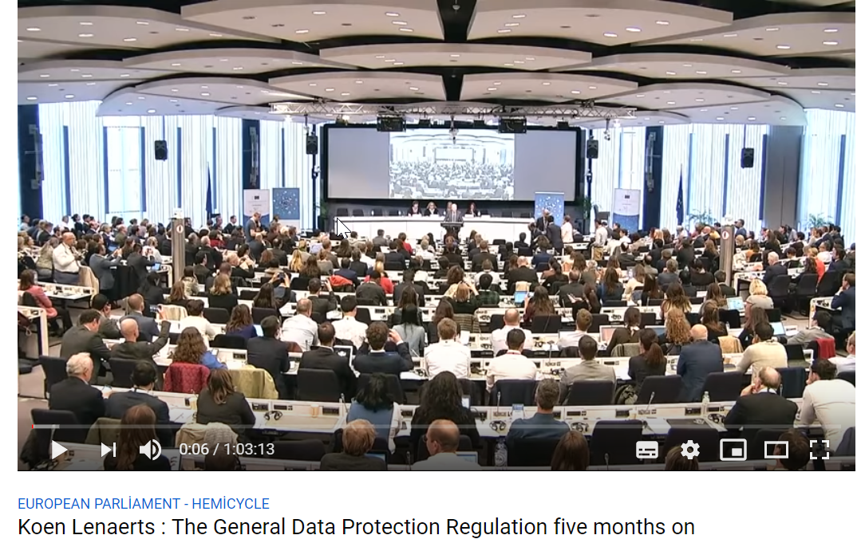

Slide 74
Gartner Report
Predicts 2019:
  Digital Ethics,
  Policy and Governance Are Key to Success With Artificial Intelligence
Published: 07 December 2018, https://www.gartner.com/doc/3895092

Slide 75
2019 AGENDA
Cloud and Data Flow, February 2019, Ankara
Ethics, April 2019, Istanbul
Digital ID&Blockchain&TSP, March 2019, Istanbul
The NoC «GDPR Summer School», June 2019, Istanbul
IT Talks (Finance, Health, e-Communication, IT), Ankara&Istanbul

Slide 76

leyla.keser@gmail.com
https://itlaw.bilgi.edu.tr

